Slide 1
Brain Appropriate Strategies for
School-Age Learners
Dr. Regina Rei Lamourelle
Santiago Canyon College
Orange California
Chantal Lamourelle, MS
Santa Ana College
Santa Ana, California
If you are planning for a year, sow rice;
If you are planning for a decade, plant trees;
If you are planning for a lifetime, educate people.
Chinese Proverb
California Association for the Education of Young Children Annual Conference
Santa Clara, CA
April 12, 2019
Notes:
I really like this quote because it lets us know what is really important and the reason I enjoy so much sharing what I have learned about the brain with audiences like you. Learning, like love has no value unless it is shared. It is important that we, as educators recognize the value of the information available about how learning occurs, evaluate it and incorporate what makes sense to you as an educator into your classroom practice. What makes no sense to me is that all of us have spent years in the classroom as either students or teachers and very few of us know anything bout how the organ of learning functions. We may have studied pedagogy and course content in college but very few teacher preparation programs have included information about the biology and physiology of learning. This situation is similar to doctors going to medical school to learning how to fix and recognize diseases but without a foundation in the anatomy and physiology of the human body. This evening, we are going to look at a bit of the underpinnings of the science behind what we think we now understand about the brain. I qualify this a bit since what we know about the brain has exploded since George Bush declared the nineties, the decade of the brain. Out of that political act, came thousands of research projects that have refuted some of the myths about what we assumed was going on in the brain as it applies to learning.

Slide 2
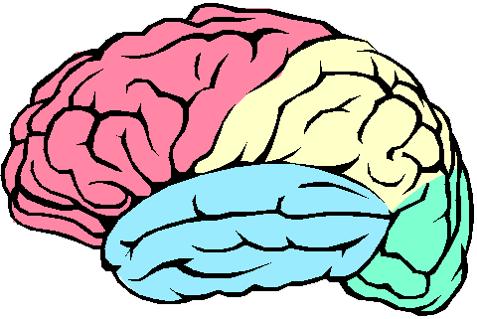
About the Brain. . .
Adults are not ineffective in their interactions with children because they do not know what happens at the synapses or brain chemistry, rather they have yet to embrace the brain as the organ for interacting and to fit instruction, parenting, caregiving, and teaching to the nature of the brain as it is now understood .
It has long been understood as a consequence of evolution, the brain has modes of function that are natural and effortless. Understanding brain operating principles can help caregivers utilize the power of this tremendous organ.

Slide 3
Coerced to operate and interact against natural maturation and developmental timetables, the brain functions with a abundant error. (Leslie Hart, 1983)
Crime, poverty, learning disabilities, misbehaviors, child abuse, and all social interactions affect and reflect in brain function.
How can the puzzle of interaction be unraveled without more knowledge of what shapes the brain and how the brain shapes us?

Slide 4
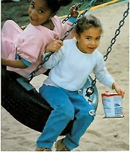
Rule #1- Uniqueness
The brain is the only organ to shape itself based on what happens in the outside world. There are no two brains that are alike.
Your brain is a biological marvel. It has more connections that all of the stars in the universe and it is not identical to another brain!
For the educator, this means that using standardized or rigid, educational strategies that do not allow for the differences in brain organization may shortchange many students.
Notes:
This has been said so often that it is rarely thought about. What does this really mean when we refer to brain uniqueness? When we were conceived from one male and female gamete or sex cell there was a one in 64 trillion chance that you would turn out to be you. The environment in your mother’s womb and her external environment further shaped you to become you. When you were born, your life experiences, what you did or did not do, and how you were treated all became the master sculptors of the brain you have today. You, as educators of children are sculpting brains! Let’s play a game to see how unique you are. (Paper Folding Game)

Slide 5
Standards are meaningless for individual brains. Every brain needs an individualized education plan!
Each brain is unique because it has been shaped by unique life experiences.
Experience includes, but is not limited, to everything a person has or has not done, seen, felt, reacted to, eaten, studied or not and places lived before and after birth.

Slide 6
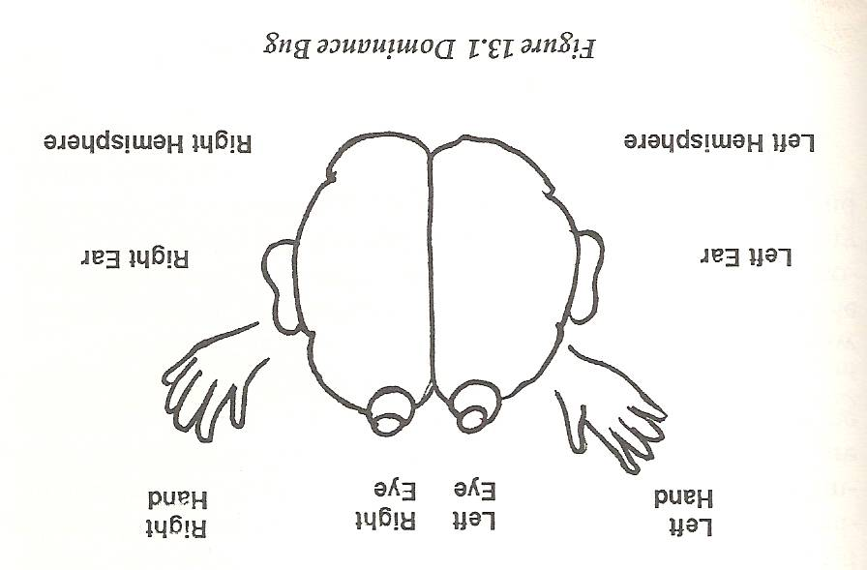
Unique Dominance Profiles
Education does not encourage holistic profiles
Education institutions favor full access children who are linear processors ( left brained, right eyed, right handed, right eared about 15% of the population)
The largest segment of the gifted and talented population is the full access profile
The largest segment of the learning disabled group is global, right-brained, left-handed, left- footed, or a combination of these
Are we assessing giftedness or brain style preferences?
According to Hannaford, ...My study also profiled teachers in the subjects schools. A full three out of four, 75% of them, were logic dominant, right-handed, right-eyed, and auditorially limited. Under stress, people with this profile tend to talk about details, not listen, and expect students to look at them!

Slide 7
Gender Matters!
Female Left hemisphere develops earlier than right | Male Right hemisphere develops earlier than left impacting discipline and sport’s preferences
Larger Corpus callosum/more fibers | Narrower corpus callosum
Monthly cycle fluctuations (estrogen/progesterone) boosts spatial and math scores | Testosterone helps abstract manipulations and spatial relations, science math, sports, business, computer, etc
Brain more diffuse, thinking spread out over a wider area | Brain more compartmentalized
Hypothalamus uses positive internal feedback increasing hormone fluctuations | Hypothalamus uses negative internal feedback reducing hormonal fluctuations
Higher Seratonin linked to shyness and low-self concept | Lower Seratonin- Linked to outgoing and positive self image.

Slide 8
This Means. . .
Under stress, your dominant brain style takes over. This cannot be changed. Most effective brain styles do not have the eye dominance and brain dominance in the same hemisphere.
Right brain learners need to learn by moving, using music, emotion and be able to access intuitive understanding.
These children are the most affected by early academic pressure to read. Easel painting , dramatic play, music, and gestalt type learning has been devalued and removed from most kindergartens.The strategies remaining favor left brain children and linear learning
Male brains do not mature at the same rate as female brains for early academic learning.
Practical Example: Let’s see how this paper folding exercise represents the influence of uniqueness.

Slide 9
#1- Brain Appropriate Strategies for
Incorporating Uniqueness into Learning Activities
Build several ways an assignment can be completed, not just one strategy.
( Reports, Mind Maps, Poems, Raps, Learning Stories, Plays)
Using the multiple intelligence profiles may be a way to accomplish this.
Allow for the different processing abilities for individual children. For example, rigid due dates and short timelines pressures to learning times tables may be counter productive for trauma sensitive children, those with auditory delays or other processing limitations.
Practice empathy, connections, and community

Slide 10
Rule #2: Social Networking is Innate
The human brain is a social brain.
The brain grows and develops from interactions and experiences with others. Isolation, apathy, neglect, or poor stimulation deprive the brain of the necessary stimuli to make healthy connections.
Learning centers, play, and cooperative curriculum are brain compatible ways to use this brain natural learning design to benefit educational goals.
Peer feedback and support is also good for wiring information, improving mood and self-concept

Slide 11
Let’s Give them
Something to Talk About . . .
Age old problem of classroom chatter can be channeled into productive curriculum.
-Boredom causes the brain to seek stimulation
-While some repetition is good, overused repetition does not capture the attention of the novelty seeking brain
The Mirror Neuron system needs real-world interactions to properly wire prosocial behavior and meaning.
Being there and personal simulations are better for brain wiring than talk and worksheets.
Worksheets have limited value in building brain networks!

Slide 12
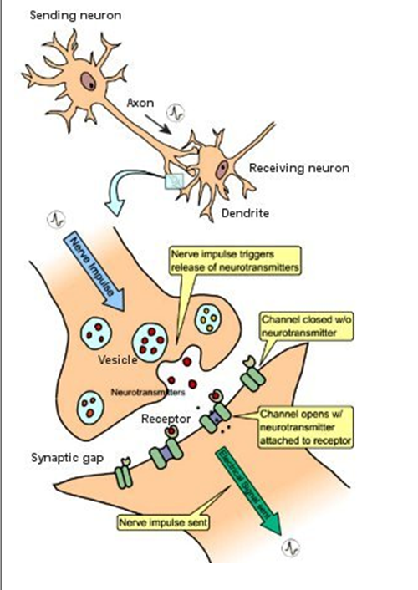
Learning at the Cellular Level
The axon sends electro-chemical messages
(neurotransmitters) to the dendrites. The dendrites receive the messages in coves or gaps that are called synapses. The receiving neuron takes the neurotransmitter from the synapse and translates it into an electrochemical signal to send down to another axon and start the process all over again.

Slide 13
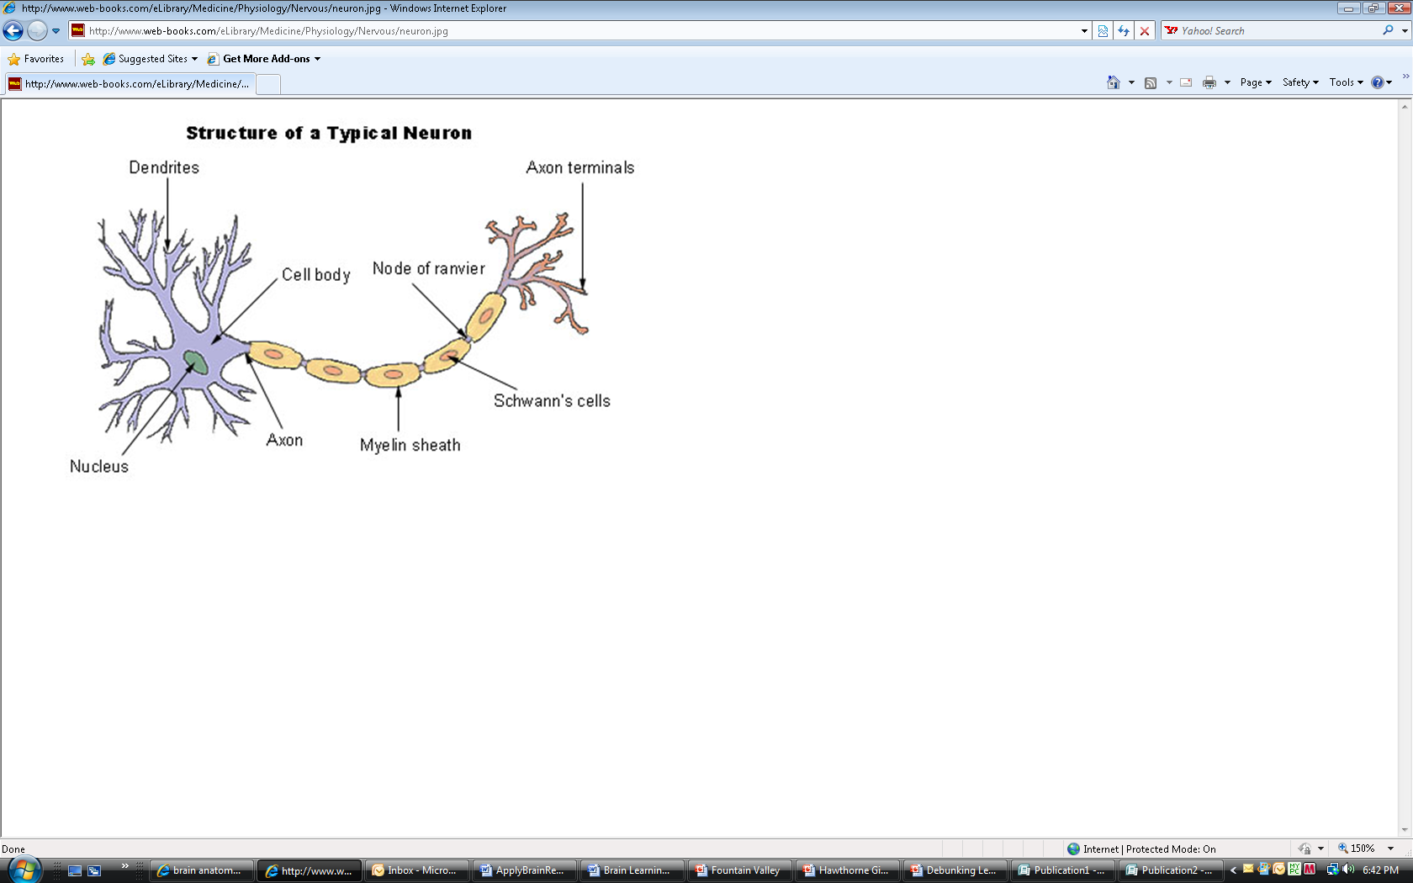
Learning is the process of repeated firings and patterns of depolarization of these chemicals so that entire groups of brain cells respond automatically with little motivation.
Brain functions that wire together will happen automatically with minimal triggers.
A single neuron can connect to 10-15,000 thousand other neurons in this manner making for an efficient transfer of electro-chemical messages.
Fatty sheath (myelin) cover speeds nerve transmission- Myelination
When complete, the actions can be performed with less effort. Learning has occurred when the information can be recalled easily

Slide 14
#2- Brain Appropriate Strategies to Facilitate Myelination: Implications for Educators
Do not test too soon. Myelination for new up retrieval
( meaningful, songs, powerful analogies or examples)
Survival mediated events and novel ones tend to get the most brain attention because it may make it easier for the brain to view this as important and take action.
Music, motor activity, rituals and celebrations are ways to create novelty for speeding up this process.
Brains must do what we want them to learn.
Movement cause the brain to release nerve growth factors that facilitate the myelination process we call learning
Practical Example-Energy Tube Demonstration
Notes:
While a child is practicing a new skill or learning new knowledge, this process is occurring more slowly with more effort because these new networks need a fatty sheath of myelin to speed the transmission of the information. When myelination is complete, learning has occurred and the skill or information can easily be used or recalled.
Implications for Educators: Sometimes tests and evaluations are done too soon for individual children and their brain has not yet completed this process. It may take as little as a few seconds for survival impacted events to three weeks for less survival mediated events. This may be one reason why the more emotion and the importance of using as many senses as possible while learning new material, the easier it is for the brain to view this as important and to take action. A brain that feels safe ( not in survival mode) , music, motor activity, ritual and celebrations are ways to create novelty for speeding up this process.

Slide 15

Rule #3- The Brain is a
Multi-Faceted Processor
The brain processes many different kinds of sensory energy at the same time.
Sight, Taste, Hearing, Smell, Touch, Vomernasal, Ultraviolet, Proximal, Electrical, Pain, Balance, Vestibular, Barometric, Geo-gravimetric, Temperature, Eidetic Imagery, Magnetic, Infrared and Ionic make up the 19 kinds of sensory information processed simultaneously
Humans have 5 SENSE ORGANS
but at least
19 SENSES
Notes:
The brain can and does process many different kinds of information at one time. There are four brain lobes that process different kinds of information and integrate this information at nana speeds for action. When a child is asked to respond to a question in class, think about what discrete functions the brain has to manage at the same time. The eyes scan the scene for any threats to survival and for non-verbal content relevant to the questions. The ears must transmit distiinct bits of sound to the auditory cortex in the temporal lobe for interpretation . Before that, the bits of sounds were evaluated in different parts of the brain depending on whether they were nouns, verbs etc. If you were a non-native speaker, these operations may be located in different brain lobes and the brain needs to find them. Meanwhile, the parietal lobe is integrating the words and sounds together to formulate a response. The frontal lobe has been attentive to making meaning out of the questions and retrieving stored information that may be relevant to their response. The deep limbic systems must make sure that the appropriate emotional content is added and must also be interpreted how the questions was asked and closely monitor threats. The hippocampus monitors the information and is in charge of storing information in short term and alter long term memory. All this and more is happening at nano second speeds without conscious thought. Children with damage to their brain systems may not be able to decode and encode informational as rapidly as needed to make meaning and to respond in the "typical" amount of time.

Slide 16
#3-Brain Appropriate Strategies for Multi-Faceted Processing
Use hands-on learning as much as possible
Use a variety of learning examples using multiple intelligence strength information
Plan" being there moments" as much as is feasible
Bring back field trips and internships for older learners
Invite guests and other outside experts whenever feasible
Find ways to connect learning to the community. I participated in a project where the students interviewed community elders and created a biography for them. (English and History focus)
Write letters to advertisers or manufacturers complimenting their product or pointing out what else could improve their brand. (A 9 year-old girl got Golden State Warrior, Stephan Curry to make shoes that appeal to women and girls)
Allow students to present major projects using their multiple intelligence strengths or personal preference
Make homework short and meaningful

Slide 17
Rule # 4 - Learning is Enhanced by Challenge and Reduced by Threats
Stress, threats and trauma hijack brain’s higher order learning system(frontal lobe or thinking part brain) in favor of the survival systems
(Limbic system-fight or flight)
Survival overrides learning
Test anxiety is the cousin of fear
Pop quizzes, some timed tests, and being called on in class may evoke fear responses in some students decreasing their chances of academic sucess and healthy social-emotional development .

Slide 18
Defining Stress. . .
The label of stress can be misleading, however, Biological stress is any event that forces the normal physiological and neuro-physiological systems to function outside of their normal parameters. (Perry, 2000)
Trauma is the neuro-physiological, neuro-psychological and chemical events that are the adaptive responses brought on by stressors. This could be words, actions, environmental mishaps, internal struggles, etc.
Notes:
It is important to remember that stress and trauma are relative to each individual and the brain and body will respond accordingly.

Slide 19
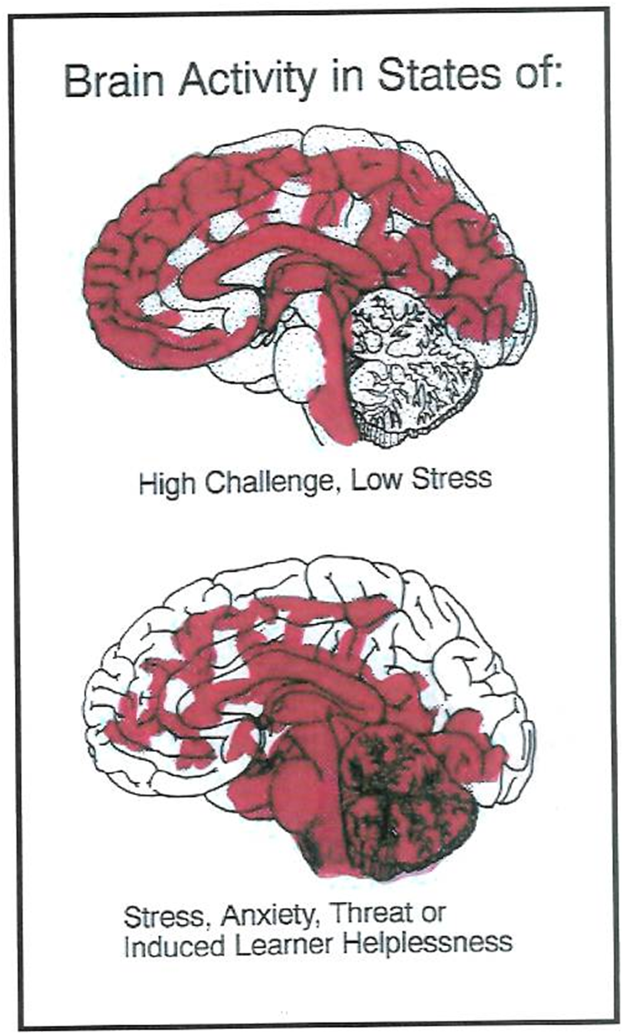
Brain Blood Flow During Stress
Thinking Area-Prefrontal Cortex
Calm Emotional Center-
Limbic System
Incoming
Brain Signals
Thinking Area-Prefrontal Cortex
Stressed Emotional Center
Incoming
Brain Signals

Slide 20
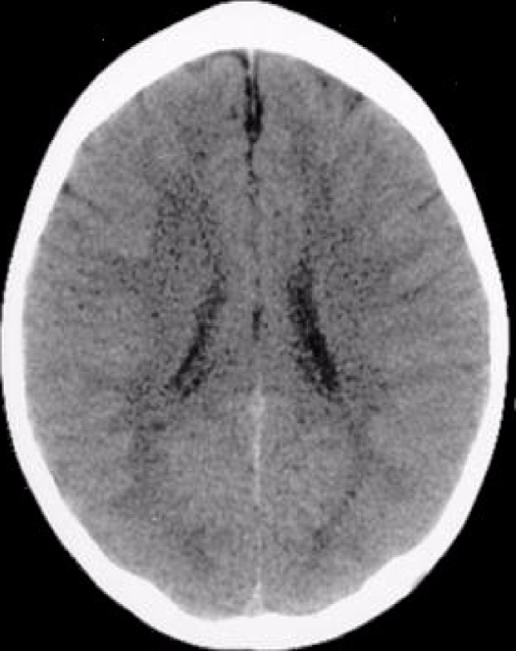
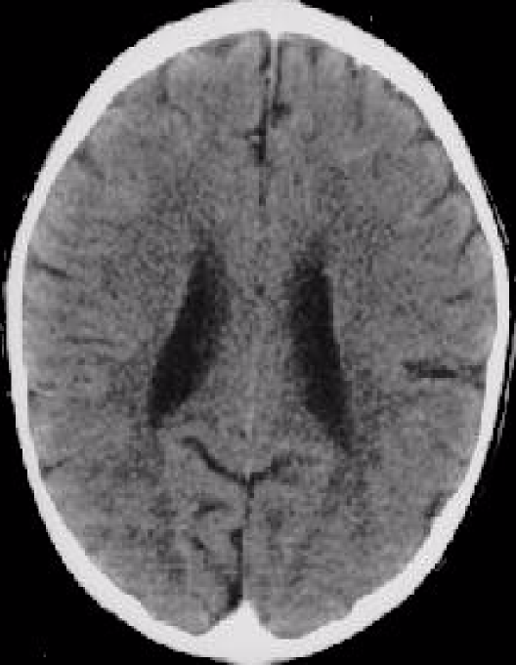
LIFE-LONG EFFECTS OF TRAUMA
N
O
R
M
A
L
B
R
A
I
N
ABNORMAL BRAIN
These images illustrate the negative impact of neglect on the developing brain. In the CT scan on the left is an image from a healthy three year old with an average head size. The image on the right is from a three year old child suffering from severe sensory-deprivation neglect. This child’s brain is significantly smaller than average and has abnormal development of cortex.” “These images are from studies conducted by a team of researchers from the Child Trauma Academy led by Bruce D. Perry, M.D., Ph.D.”

Slide 21
EMOTIONS RUN THE BRAIN
Frustration/Worry/
Concern
Anxiety/Tension
Satisfaction
Low-Moderate Stress
Excitement/Joy/Bliss
Optimism/Hope/Love
Disappointment
Discouragement
Rejection/Sadness/
Grief
Contrary to popular belief, the “ negative” states are normal emotional states
There is little growth in the comfort zone. Some challenge and stress are an in evitable part of the human experience and necessary for wiring a full range of emotional responses…
These emotions are also important for lean ring since all incoming information must pass through the emotional brain
Notes:
All learning enters the spinal column nerves and through the brainstem and limbic center before it reaches the frontal lobe. If the limbic systems perceives a threat, this is what gets the brains attention not the higher order learning. Brains are wired for survival first. School learning is way down on the list of priorities for the brain. There are ways to elevate the importance and this usually means using the brain’s innate wiring and quirks to get at the learning.

Slide 22
Trauma Brain Versus Learning Brain
Trauma Brain
Focused on survival
Cannot see the big picture
Is hypervigilant
Normal events may be perceived as threats
Worry and blame predominate thinking
Learning new information is not a priority
Memory storage and retrieval are hampered
Executive functions decrease (self-regulation, creativity, problem-solving, and impulse control)
Body releases major amounts of stress hormones (Cortisol) that prepares the body for a fight or flight
Learning Brain
Focuses on learning from novelty
Is calm and able to deal with ambiguity
Is hopeful and views actions as possible solutions to problems
Can deal with ambiguity
Learning becomes possible
Body releases some cortisol but other hormones and neurotransmitters involved in learning are released too
Executive functions are intact and are available to be used to solve problems, be creative, and control impulses
Normal pruning and refinement of learning networks proceeds normally
Pruning can be normal or abnormal. Developmental pruning that occurs through brain maturation to improve the efficiency of the brain such as what occurs during puberty is normal. Pruning that occurs because of too much stress limits the brain.

Slide 23
#4- Brain Appropriate Strategies for Reducing Classroom Trauma
Enlist classroom attendees in making reasonable rules and consequences
Remember that “Mistakes” are fuel for learning and not an opportunity for punishment
Regularly assess the stressors in your classroom and remove them
Add music and calming aromas whenever feasible. Use lavender, lemon, mint
or chamomile braindough
Create teams that can bond as a support group
Understand and practice positive discipline classroom management strategies rather than controlling practices
Relax rigid deadlines that may be more child stressors than motivators
Practice mindfulness with calming jars. Student can make their mindful jars at the beginning of school so that they have them when needed.
Symbolically release automatic negative thoughts and fears (writing on paper and throwing away, sending adrift with paper airplanes)

Slide 24
Rule#5- The Brain Processes Parts and Whole Information at the Same Time
Left Brain
Learns in sequence
Works with distinct facts and parts, the puzzle pieces
Better at language
Better at detail
Acts as interpreter
Not always logical
Right Brain
Learns randomly
Works with whole information the big picture, the picture of the puzzle on the box
Better with pictures
Gives meaning to space, time, and color
Not always creative

Slide 25
“'Twas brillig, and the slithy toves
Did gyre and gimble in the wabe;
All mimsy were the borogoves,
And the mome wraths outgrabe.

Slide 26
Rule #6-The Brain is Meaning-Driven
The brain innately seeks meaning to understand.
The search for meaning occurs through patterning.
The brain uses past information to interpret new information.
This makes a good case for using prior learning or priming the learning apparatus.
The brain is run by patterns not facts. Televised media ingrains patterns that may be antisocial or untrue. The brain can’t help by make “patterns” or meaning of the volumes of data. Reports are that children watch 5-8 hours of television a day.
Notes:
The brain is meaning-driven and attention is secondary (use it 20% or less). We gain meaning three ways: by making patterns, using our emotions and finding relevance. The brain is poor at learning isolated facts without feelings or meaning tied to the learning. People learn best with information that is given in context, illustrates the "big picture" and is relevant. This is especially true of work that is difficult and a child does not have the necessary pre-learning to make meaning of the new learning. Consider pre-learning like the rough draft of a paper. It is easier to refine a paper from a rough draft that to start from scratch to write a paper without the prior form. When houses are built, rough plumbing or pre-learning is installed before the final plumbing and fixtures are set.

Slide 27
Doing the Math. . .
Children may view 5 anti-social acts (hitting, kicking, teasing, bullying, murders, battery, sexual violence, intimidation, name calling, racial stereotyping, etc.) while watching some television programs every 30 minutes.
5 acts /30minutes X 5hr/day= 50 acts per day
50 acts/day X 7day/wk.= 350 acts/week.
350 acts/wk. X 52 wks./yr. =18,200 acts/yr.
18,200acts/yr. X 15 yrs.= 273,000 antisocial acts that children see over 15 years. It seems reasonable that this amount of “experience” would affect how a child’s brain is organized. We see some anecdotal evidence of this all the time with the change in level and kind of teen violence along with the acceptance and complacency of horrible events by the public.
Again, the brain is run by patterns not facts. Televised media may ingrain antisocial or false patterns. The brain can’t help by make meaning of the volumes of “data.”

Slide 28
PFMFMRFP
Can you guess what this word is?

Slide 29
The brain searches through all of its information to find what makes sense.
The brain does not usually hunt for nonsense as this is not usually important for survival. We must consciously create nonsense.
One explanation why delusions are so powerful. People believe they are related to their survival or the survival of a loved one.

Slide 30
#6-Brain Appropriate Learning Strategies to Support the Brain’s Need for Meaning
Choose learning activities that are meaningful, interesting or important to school-agers.
Allow multiple ways that assignments can be completed
Relate assignments to community or personal, real world events

Slide 31
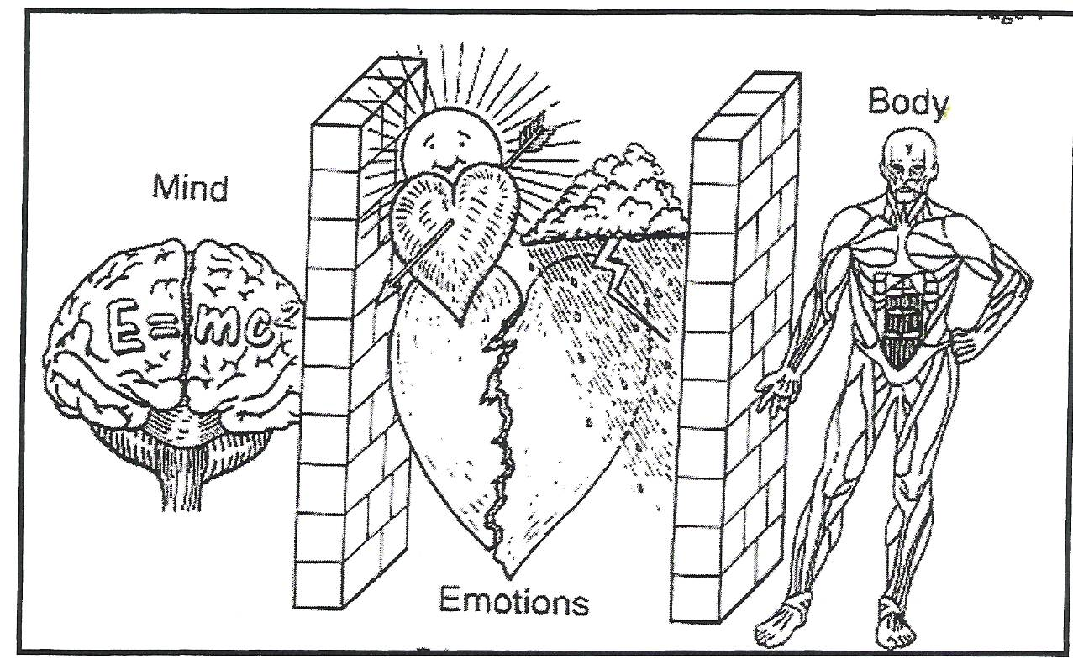
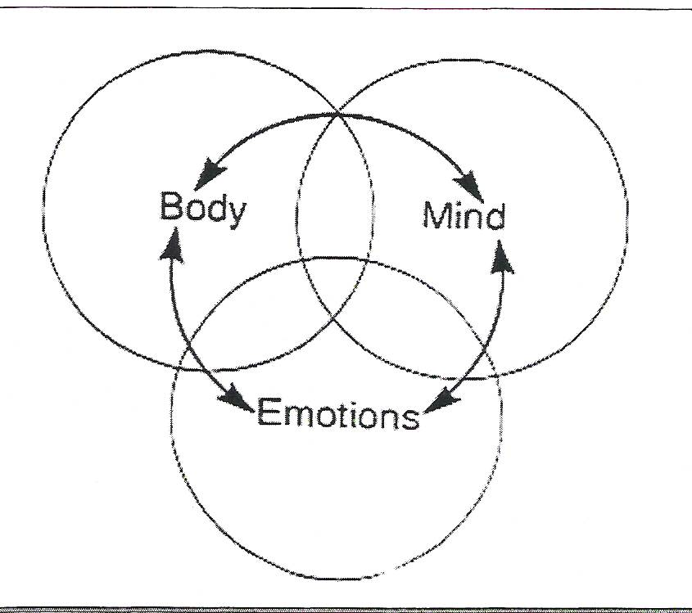
Rule#7- All Learning is Mind-Body
NEW VIEW OF LEARNING
OLD VIEW OF LEARNING
Notes:
Old view of learning. We cannot separate the mind from the body. As discussed before, our emotions filter all experience to help us choose what is and is not important.

Slide 32
Movement Wires the Brain
The brain is the only organ that shapes the internal structure based on movement in the outside world.
Movement is critical to learning
Procedural Memory systems more powerful with better storage and retrieval than semantic systems
Sitting still and being quiet may not be brain appropriate for learning
All learning is evidenced by movement. How do you show what you know? Do you just sit there ? Writing answers on test is motor function!

Slide 33
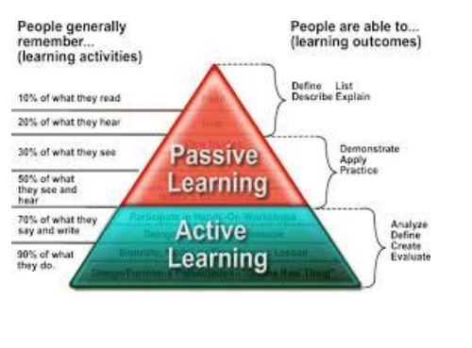

Slide 34
#7-Brain Appropriate Strategies for Using the Mind-Body Connection
Find ways to make learning playful or observe what children can learn through play (Scrapstore Playpods)
Plan body movement breaks
Use variable seating arrangements (balls, couches, floor, etc.)
Do not restrict recess as a discipline measure
Use dramatic play techniques for learning
Use mind-mapping techniques
Use music and dance as learning tools

Slide 35
Rule #8- Cycles and Rhythms are Important to Learning
The brain has natural ups and down cycles where learning is affected
Brain growth spurts precede skill development
3-5 years difference in brain maturation and no one is behind or gifted
Gender Matters- Boys lag behind girls in reading, language and social functions
Many elementary classrooms that are overly movement restricted may shortchange boys learning
4.5-7 | Whole picture processing, image, movement, rhythm, emotion, intuition, outer speech, integrative thought
7-9 | Details, linear processing, refined language elements, reading and writing skills, sports techniques, linear math
8 | Fine motor development, social behavior and control, fine motor eye tracking and focus ( Hannaford, 1991)
Notes:
The growth for the Right Brain is between 4.5-7years. What is developing then is whole picture processing, cognitive processes, image, movement, rhythm, emotion and intuition, outer speech and integrative thought.
The growth spurt for Left Brain is between 7 and 9 years of age. What develops: Reading processes, detail and linear processing/cognition, language refinements, skills development in sports, liner math processing.
The Frontal Lobe undergoes a growth spurt at age 8 which helps skill development, development of inner speech, control of social behavior, fine motor eye movement for tracking during reading.

Slide 36
Rule #8- Cycles and Rhythms are Important to Learning
Timing is everything
The brain is poorly designed for rigid /“on task” learning
The brain needs a “timeout” to fix neural pathways
Age (Years) | Focused Learning (Minutes) | Rest Time
4-5 | 5-7 | 1
10-11 | 13-15 | 2
14-18 | 21-22 | 2
Adults | 21,30,45 blocks | 2,3,5 minute rest blocks

Slide 37
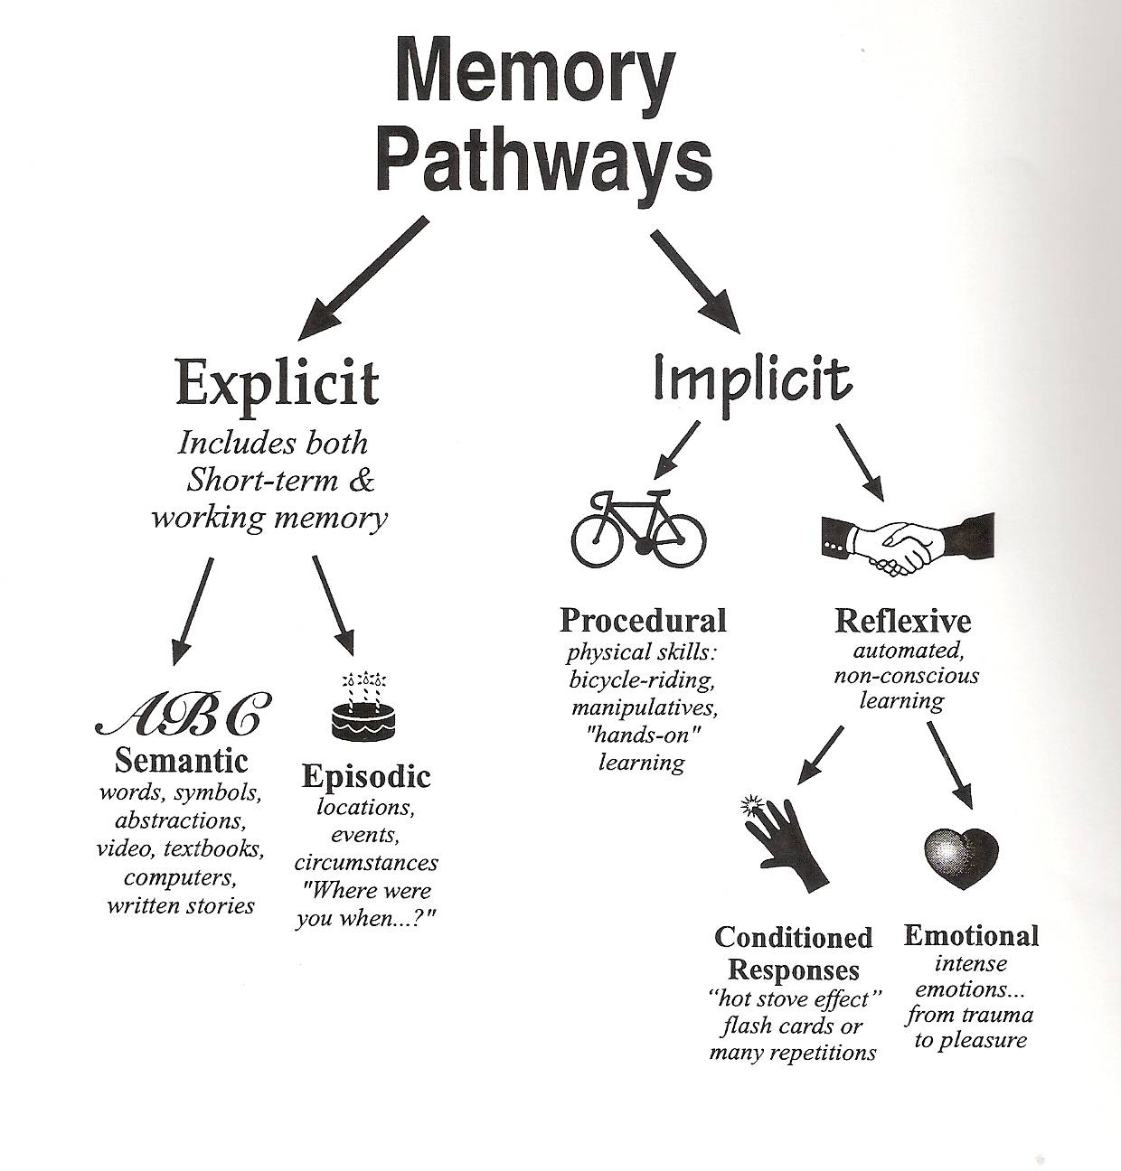
Rule # 9-There are at Least Two
Different Memory Systems
Semantic-(Brain) General Knowledge, labels, names, facts, data-Located in the Hippocampus. Limited storage capacity. Requires high level of motivation and triggers for retrieval.
Useful Strategies to Support: graphic organizers, questioning, outlining, debating, paraphrasing, mnemonic devices, etc.
Episodic( Brain)- Life experiences, unexpected events, location, spatial memory, celebration, accidents, death, divorce, disagreements, opposing points of view. Located in the Hippocampus.
Useful Strategies to Support : Novelty, bulletins, role-playing, colorful handouts, sudden noises or surprise music

Slide 38
Rule # 9-There are Two Different Memory Systems and Strategies for Support
Procedural (Body centered)–Involves skill development, practice, rehearsal movement. Located in the cerebellum. Unlimited storage capacity with ease of retrieval.
Useful Strategies to Support : Movement, performances, routines, rituals.
Emotional ( Body/Amygdala)
Activated by emotional highs and lows that are unusually high or low. The lowest of the low and the highest of the high (Usually perceived by the brain as a survival threat. Located in the Amygdala. Unlimited, easy retrieval after years.
Useful Strategies to Support -Positive and negative emotional experiences, celebrations, debates, simulations, arguments, surprises

Slide 39
Rule#10-Learning Involves Conscious and Unconscious Processes
The brain never sleeps
During sleep the brain repairs circuits and stores memories
In children and adolescents, the brain releases growth hormones during deep sleep
Rest periods during the day help the brain store learning

Slide 40
SUMMING UP. . .
Children’s brains are Unique
Children are born to be a part of a social group. Supportive relationships is the best antidote to trauma
Children’s brains are meaning driven
Cycles and rhythms of physical development affect all aspects of a child’s interactions with caregivers
There are at least two memory systems involved in learning
Brains need food, water and sleep to thrive (and behave)!
      Emotions are critical to learning
The brain is a multi-pathway processor that can process parts and whole information simultaneously in different modalities and is rarely over-stimulated
All learning is mind/body
Memory is dynamic and is created each time we recall an event. Apparently, we store memory in many body cells.
The brain is highly adaptive and thrives on healthy, novel problem-solving opportunities
Stress, threats, and trauma alter brain functions and responses

Slide 41
Brain Quotes. . .
Expecting all children the same age to
learn from the same materials is like
expecting all children the same age to
wear the same size clothing.
Madeline Hunter
The brain is the last and grandest biological frontier, the most complex thing we have yet discovered in our universe, it contains hundreds of billions of cells interlinked through trillions of connections, the brain boggles the mind.
James D. Watson
The principle goal of education is to create people who are capable of doing new things, not simply of repeating what other generations have done—people who are creative, inventive and discoverers. Jean Piaget

Slide 42
RESOURCES
Brenda Ingram, EdD, LCSW, Director of Clinical Services, Peace Over Violence. Brenda@peaceoverviolence.org
Helping Traumatized Children Learn. A Report and Policy Agenda. Retrieved at http://www.k12.wa.us/CompassionateSchools/pubdocs/HelpTraumatizedChi ldLearn.pdf
Some videos on Trauma Informed Practices in Schools Children, Violence and Trauma—Interventions in Schools https://www.youtube.com/watch?v=49GzqPP7YYk
Modules on creating trauma informed care in schools, Madison Metropolitan School District. There are 10 modules, https://www.youtube.com/watch?v=elaLV_b8FXw • https://www.youtube.com/watch?v=lJpafA1G148 • https://www.youtube.com/watch?v=YQoQS4RFJRQ
Practicing Mindfulness https://blissfulkids.com/how-to-practice-mindfulness-with-children-the-essential-guide/

