Slide 1
“Caregiving with the Early Childhood Brain in Mind”
Regina Rei Lamourelle,Ed.D
Santiago Canyon College, Orange, CA
National Black Child Care Annual Conference
Orlando, Florida
October 2, 2016

Slide 2
About the Brain. . .
Adults are not ineffective in their interactions with children because they do not know what happens at the synapses or brain chemistry, rather, they have yet to embrace the brain as the organ for interacting and to fit instruction, parenting, caregiving, and teaching to the nature of the brain as it is now understood .
Notes:
This quote was taken from a quote by Lesley Hart( 1983)

Slide 3
It has long been understood as a consequence of evolution, the brain has modes of function that are natural and effortless. Understanding brain operating principles can help caregivers utilize the power of this tremendous organ. Coerced to operate and interact against natural maturation and developmental timetables, the brain functions with a abundant error.
Crime, poverty, learning disabilities, misbehaviors, child abuse, and all social interactions reflect brain function. How can the puzzle of interaction be unraveled without more knowledge of what shapes the brain and how the brain shapes us?
Notes:
Our educational institutions do not practice education taking into account how brains develop or use the advances in cognitive science. Essentially, we are practicing education the way it was designed in the 1880’s!

Slide 4
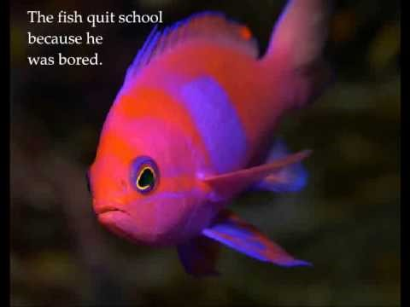
ANIMAL SCHOOL by RAISING SMALL SOULS.COM
Notes:
So how many of you are bees? You were told that your wings were too small and you could not fly? How many boys of color are shunned or told they do not fit in because they are too. . .?

Slide 5
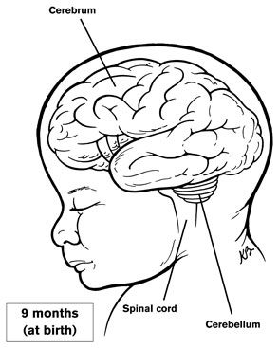
Shaping the Caring Brain. . .
The brain is the only organ that shapes its internal structures based on the experiences in the outside world.
Negative events profoundly affect the brain, behavior, and development
It matters when, what, how, and why we do what we do for children!
Notes:
A child who is raised in an impoverished or abusive environment has a brain developed and influenced by the environment. Ethnic and color group affiliation are factors that affect how a brain is wired. Note that I did not use race because there is no scientific evidence to justify the social construct of race. There is a human race with variation in color group and expression of ethnicity. Responsive and consistent care giving practices in infancy wire the brain for expression of these attributes when children up.

Slide 6
Rule #1-Each Brain is Unique
Each brain is unique because it has been shaped by unique life experiences.
Experience includes,
but is not limited, to everything a person has or has not done, seen, felt, reacted to, eaten, studied or not and places lived before and after birth.
Notes:
The brain is the only organ that is shaped by outside experiences. The first experience is the template that will affect all future experiences. Think about the templates for empathy, sympathy, critical thinking, self-control, and learning that are affected by poor or inconsistent infant care? Most licensed infant care facilities are not excellent quality and many infants are cared for by some of the least qualified caregivers. Infant care is scarce and expensive so how do you see this affecting the long-term brain organization of future students.

Slide 7
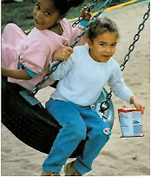
And. . . .
Male and female hormones change how the brain is wired and how it responds to the world.
Boys and girls experience the world differently! Slow to warm up babies, children who stay focused and cannot switch gears, are more sound and touch sensitive children experience the world as their brains allow them to!
Notes:
Boys are louder, need more room to move, and have more difficulty hearing verbal instructions especially if they are not looking a the face of the speaker. Boys do not hear as well as girls so they may miss some verbal instructions and be misjudged as ignoring the caregiver when they just did not hear properly.

Slide 8
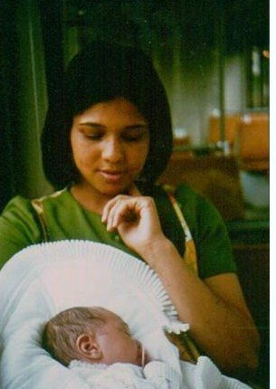
The brain is a biological marvel.
It has more connections than all of the stars in the universe and it is not identical to any other brain that has ever existed!
Notes:
Each brain is shaped by a unique set of experiences upon a unique combination of DNA. Standardized curriculum is mathematical calculation not a certainty for many individual brains. Upon conception, one male and female can create 64 trillion different combinations of unique children and hat is not considering the alternative conception possibilities where some embryos have three genetic parents.

Slide 9
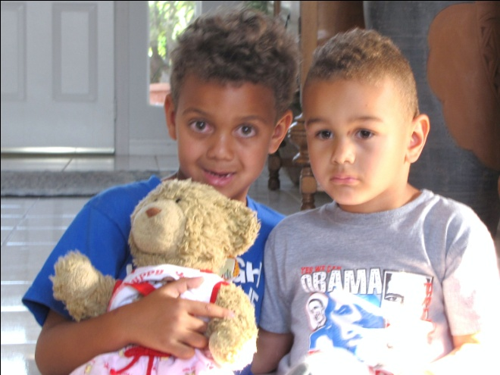
For caregivers, this means that using standardized or rigid, caretaking strategies that do not allow for the differences in brain organization may shortchange many children.

Slide 10
Unique Dominance Profiles
Education does not encourage holistic profiles
Favors full access children who are linear processors ( left- brained, right-eyed, right-handed, and right-eared or about 15% of the population)
The largest segment of the gifted and talented population exhibits the full access profile
The largest segment of the learning disabled group is global, right-brained, left-handed, left-ear dominant, or a combination of these
Are we assessing giftedness or brain style preferences?
It is easier for a child whose sensory and motor systems function as predicted to have prosocial behavior than one who does not.
Notes:
Do paper folding exercise to show uniqueness and the effect of standards.

Slide 11
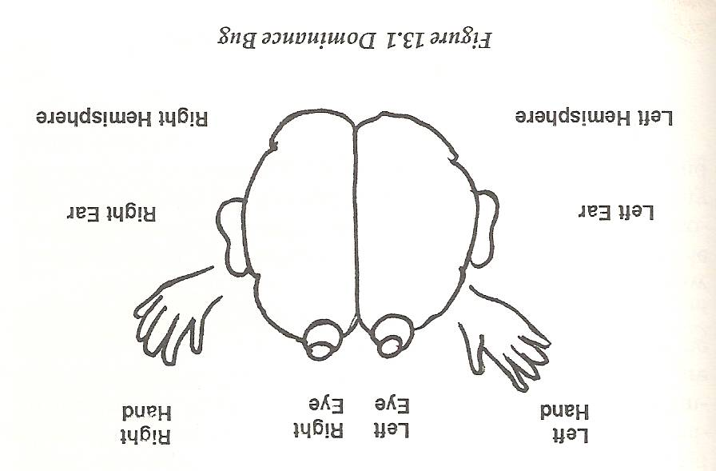
Carla Hannaford, “Dominance Profiles”
According to Dr. Hannaford, ...
“My study also profiled teachers in the subjects schools. Full three out of four, 75% of them, were logic dominant, right handed, right eyed, and auditorially limited. Under stress, people with this profile tend to talk about details, not listen, and expect students to look at them!”

Slide 12
Prime Brain Building Times
These brain volume figures represent growth in not only volume but also what a child can do. What a child’s brain can do is directly related to what he/she has experienced.
There are more “firsts” in a child’s life from birth to age one than there will ever be at any other time in life.
Each first experience is a template for future experiences!
AGE | Approx. Vol. (cc.)
Birth | 330
One Year | 750
Two Years | 900
Four Years | 1,000
Twenty Years | 1,200
Notes:
Looking at the changes in volume here, think about what an infant can do at birth and think about what a one or two year old can do. When brain do not grow as planned in the first years, children are not able to do what most infants can do.

Slide 13
Role #2-Caregiving Requires a Social Brain
The human brain is a social brain.
The brain grows and develops from interactions and experiences with others. Isolation, apathy, neglect, or poor stimulation deprive the brain of the necessary stimuli to make healthy connections.
Learning centers and cooperative curriculum are brain compatible ways to use this brain natural learning design to benefit educational goals.
Isolation of infants from a “social group” may not provide healthy brain stimulation.

Slide 14

Caregiving Behaviors are Learned
All Humans Are Wired to Express
Humans Must Learn to Express:
Sadness
Joy
Anger
Surprise
Fear
Disgust
Empathy
Optimism
Sympathy
Humility
Forgiveness
Compassion
Patience
Shame
Cooperation
Notes:
We must learn to be prosocial. I could be that for most children environments are overly permissive, aggressive, etc. do not give children’s brains the variety of emotion to wire healthy prosocial behavior. I have to qualify this because we have all see and may know people who have terrible family situations but turn out to be caring, kind and prosocial. Since we learn to care, what is learning anyway.

Slide 15
Let’s Give them Something to Talk About. . .
Non-verbal communication is necessary for verbal communication to develop. The Mirror Neuron System helps children develop a library of appropriate social responses and routines for which they will add words and conversation later. Development of non-verbal communication responses occurs before verbal communication.
Link to Autism
Rhett Syndrome
Being there and personal simulations are better for brain wiring than talk and worksheets.
Worksheets have limited value in building brain networks!
Notes:
Some research suggests the autism may be an issue of lack of pruning of brain neurons or defective mirror neurons. If a child’s brain cannot mimic the purposeful movements of others that clue us into social cues, this would partially explain this deficit in many autistic children. Babies are born with the ability to mimic purposeful motor actions of caregivers.

Slide 16
Boredom or low blood flow to certain brain areas may cause the brain to seek stimulation.
While some repetition is good, overused repetition may not capture the attention of the novelty seeking brain.
The Mirror Neuron system needs real world interactions to properly wire prosocial behavior and meaning.

Slide 17
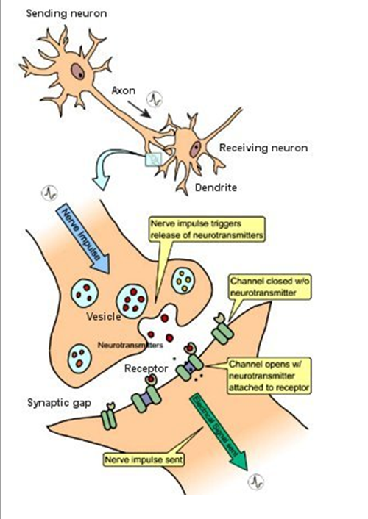
The Learning Space
Learning at the Synapse
How Signals Are Sent…
The axon sends electro-chemical messages
(neurotransmitters) to the dendrites. The dendrites receive the messages in grooves or gaps that are called synapses. The receiving neuron takes the neurotransmitter from the synapse and translates it into an electrochemical signal to send down another axon and star the process all over again.

Slide 18
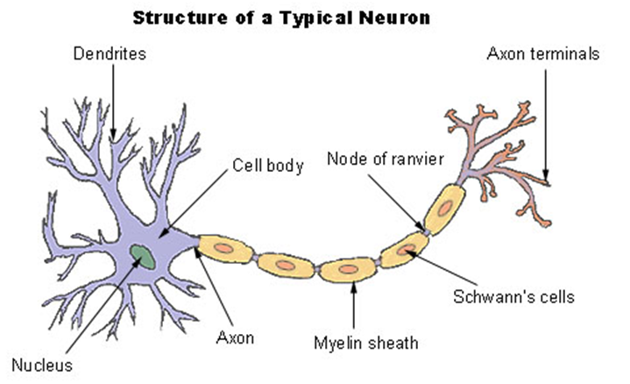
Fatty sheath covering speeds nerve transmission and when complete, the actions can be performed with less effort. Learning has occurred when the information can be recalled easily.
LEARNING = EFFORT EASY = EXERCISE
Notes:
Use energy ball exercise to show electrical floe of information along neurons.

Slide 19
Implications for Understanding the Learning Process for Caregivers:
The brain has areas that must be mature enough to process information, testing or expectations for changed behavior. Some assessments may occur too soon after learning or brain-age inappropriate
The time needed to fix learning is variable from a few seconds to three weeks
Emotionally charged learning tends to speed up storage and retrieval
Survival mediated events or novel ones tend to get the most brain attention because it may make it easier for the brain to view this as important and to take action.
Music, motor activity, rituals and celebrations are ways to create novelty for speeding up this process.

Slide 20
Learning is the process of repeated firings and patterns of depolarization of brain chemicals so that entire groups of brain cells respond automatically with little motivation.
Brain functions that fire together will wire together so that the network depolarizes automatically with minimal triggers.
A single neuron can connect to 10-15,000 thousand other neurons in this manner making for an efficient transfer of electro-chemical messages.

Slide 21
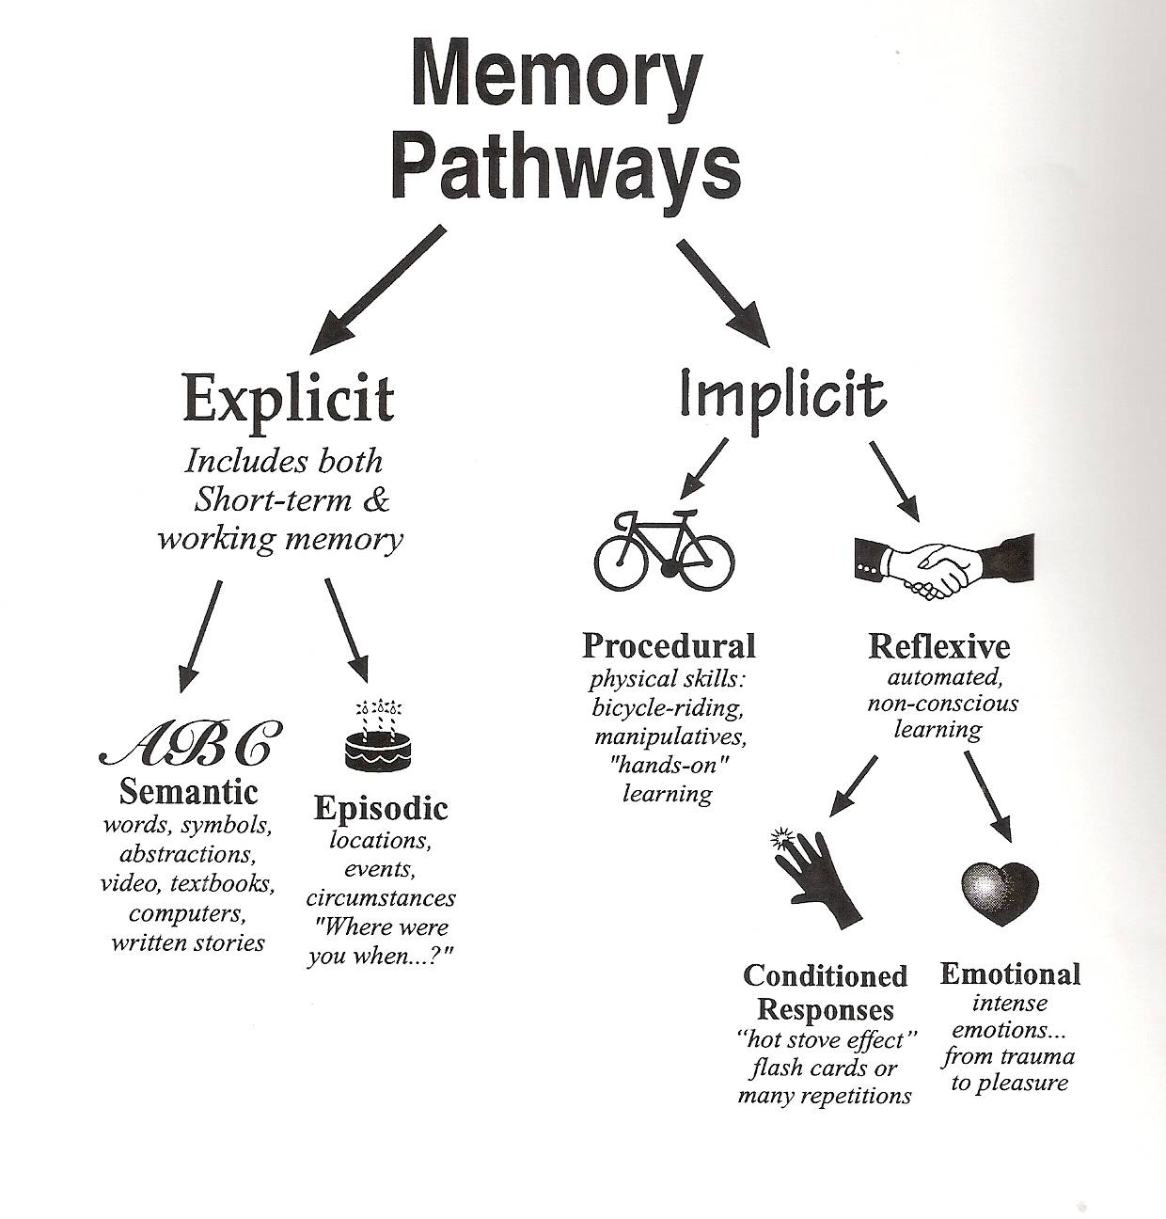
Rule # 3-There are at Least Two
Different Memory Systems
IMPLICIT MEMORY
Procedural (Body centered)–Involves skill development, practice, rehearsal movement. Located in the cerebellum. Unlimited storage capacity with ease of retrieval.
Supported by: Movement, performances, routines, rituals.
Emotional ( Body/Amygdala)
Activated by emotional highs and lows that are unusually high or low. The lowest of the low and the highest of the high (Usually perceived by the brain as a survival threat. Located in the Amygdala. Unlimited, easy retrieval after years.
Supported by -Positive and negative emotional experiences, celebrations, debates, simulations, arguments, surprises

Slide 22
Explicit Memory
Semantic-(Brain) General Knowledge, labels, names, facts, data-Located in the Hippocampus. Limited storage capacity. Requires high level of motivation and triggers for retrieval.
Supported by: Graphic organizers, questioning, outlining, debating, paraphrasing, mnemonic devices, etc.
Episodic (Brain)- Life experiences, unexpected events, location, spatial memory, celebration, accidents, death, divorce, disagreements, opposing points of view. Located in the Hippocampus.
Supported by: Novelty, bulletins, role-playing, colorful handouts, sudden noises or surprise music

Slide 23
Rule#4-EMOTIONS RUN THE BRAIN
EMOTIONAL STATES
Frustration/Worry/Concern
Anxiety/Tension
Satisfaction
Low-Moderate Stress
Excitement/Joy/Bliss
Optimism/Hope/Love
Disappointment
Discouragement
Rejection/Sadness/Grief
Contrary to popular belief, the “ negative” states are normal emotional states
There is little growth in the comfort zone. Some challenge and stress are an in evitable part of the human experience and necessary for wiring a full range of emotional responses…
These emotions are also important for learning since all incoming information must pass through the emotional brain.
Learning is affected by emotional states.
Notes:
All learning enters the spinal column nerves and through the brainstem and limbic center before it reaches the frontal lobe. If the limbic systems perceives a threat, this is what gets the brains attention not the higher order learning. Brains are wired for survival first . School learning is way down on the list. There are ways to elevate the importance and this usually means using the brain’s innate wiring and quirks to get at the learning. We learn how to be resilient by working through negative emotions. The negative emotions are our biological energy for change.

Slide 24
How Do We Learn Prosocial Behavior and Develop Our EQ?
Models- Mirror Neurons(in the frontal lobe) help us mimic movements with learning long before we acquire language.
Delaying gratification in early childhood may help children learn how to delay gratification form future successes.
Modeling and experiences for empathetic and sympathetic behavior must take place in infancy.
Televised media has little value in providing prosocial models of behavior.

Slide 25
Interpersonal experiences influence how the brain grows and develops throughout our lives.
The major structures responsible for self-regulation seem to be formed in the early years.

Slide 26
Rule# 5 - Learning is Enhanced by Challenge and Reduced by Threats
Stress, threats and trauma hijack brain’s higher order learning system(frontal lobe) in favor of the survival systems
(Limbic system)-fight or flight
However,
Survival Trumps Learning
Test anxiety is the cousin of fear
Being singled out, comparing children, excessive and unwarranted praise, testing, being called on in class, etc. may evoke fear responses in some children decreasing their chances of success and self fulfillment.
Punishments and rewards may change brain chemistry for long-term learning and memory

Slide 27
Defining Stress. . .
The label of stress can be misleading, however,
Biological stress is any event that causes any event that forces the normal physiological and neurophysiologial systems to function outside of their normal parameters. (Perry, 2000)
Trauma is the neurophysiological, neuropsychological and chemical events that were the adaptive responses brought on by stressors. This could be words, actions, environmental mishaps, internal struggles, etc.

Slide 28
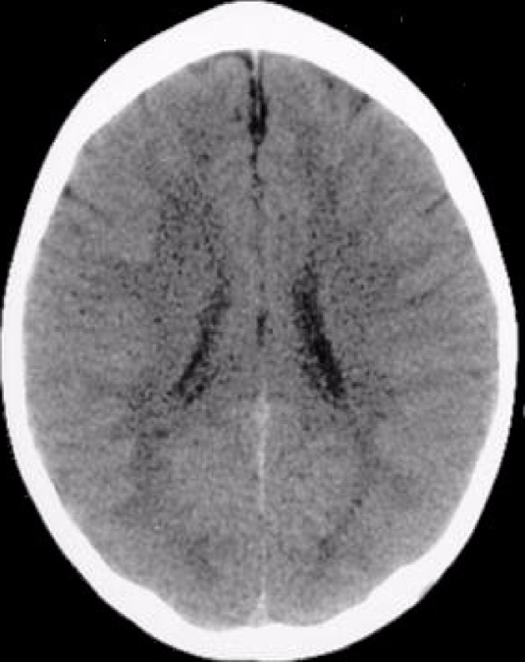
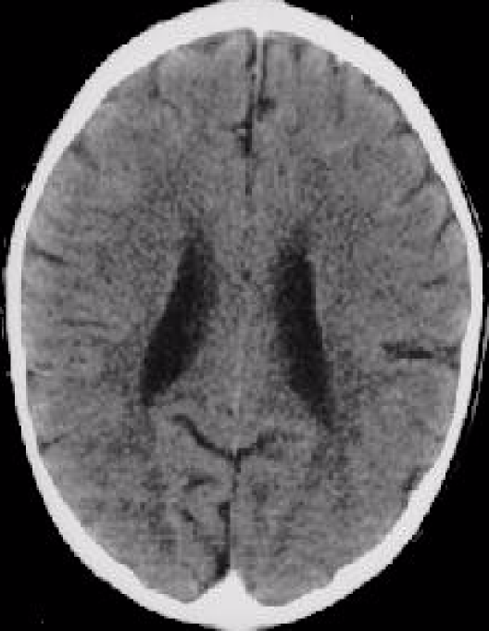
LIFE LONG EFFECTS OF TRAUMA
N
O
R
M
A
L
B
R
A
I
N
ABNORMAL BRAIN
These images illustrate the negative impact of neglect on the developing brain. In the CT scan on the left is an image from a healthy three year old with an average head size. The image on the right is from a three year old child suffering from severe sensory-deprivation and neglect. This child’s brain is significantly smaller than average and has abnormal development of cortex. These images are from studies conducted by a team of researchers from the Child Trauma Academy led by Bruce D. Perry, M.D., Ph.D.”

Slide 29
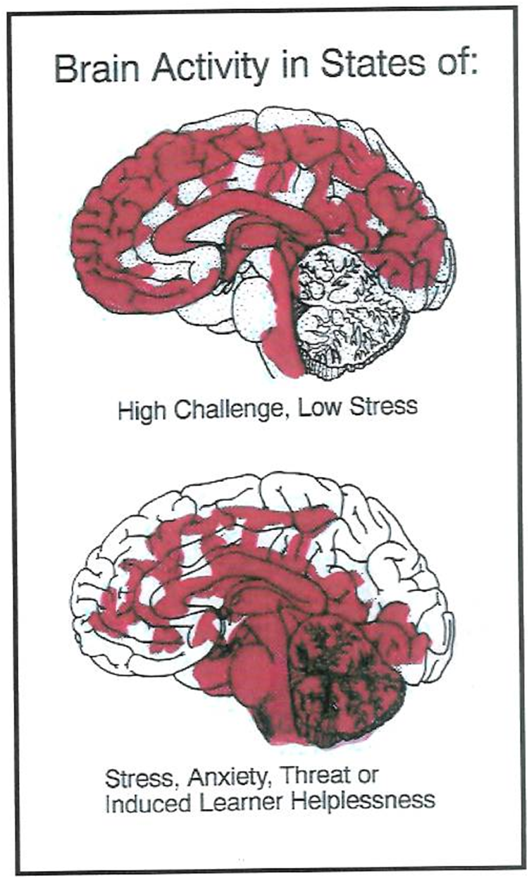
A Brain on Stress
Normal State-
High Challenge, Low Threat
Abnormal State-
High Stress, High Threat
Notes:
In the normal state, the brain has blood flow to the prefrontal context decision-making centers. Under stress, these centers do not have blood flow and, therefore, cannot function to make good decisions. This is why too much stress is not good for learning.

Slide 30
How Males and Females Respond To Stress and Threat
Adaptative Response | REST (Adult Male) | VIGILANCE | FREEZE | FLIGHT | FIGHT
Hyperarousal States More Males | REST (Male Child) | VIGILANCE (Crying) | RESISTANCE Freeze | DEFIANCE Posturing | AGGRESSION
Dissociative States More Females | REST (Female Child) | AVOIDANCE (Crying) | COMPLIANCE Freeze | DISSOCIATION Numbing | FAINTING Mini-psychosis
PRIMARY secondary Brain Areas | NEOCORTEX Subcortex | SUBCORTEX Limbic | LIMBIC Midbrain | MIDBRAIN Brainstem | BRAINSTEM Autonomic
Cognition | ABSTRACT | CONCRETE | EMOTIONAL | REACTIVE | REFLEXIVE
Mental State | CALM | AROUSAL | FEAR | TERROR | SURVIVAL/TERROR

Slide 31
Rule #6- The Brain Processes Parts and Wholes at the Same Time
Left Brain
Learns in sequence
Works with discrete facts and parts, the puzzle pieces
Better at language
Better at detail
Acts as interpreter
Not always logical
Right Brain
Learns randomly
Works with wholes the big picture, the picture of the puzzle on the box
Better with pictures
Gives meaning to space, time, and color
Not always creative

Slide 32
Although each hemisphere is specialized to do certain functions, the brain hemispheres must work together. Some scientists believe that learning disabilities are really right/left brain imbalances.

Slide 33
Symptoms or Right/Left Brain Imbalances
Poor written and oral communication
Poor reading and written comprehension
Inability to Organize
Lack of focus
Reading and Spelling Problems Inability to follow Directions
Lack of Concentration
Difficulty understanding Cause and Effect
Poor Sequencing
Confusion when given small bits of information
Poor social skills
LEFT BRAIN
Inappropriate laughing and giggling
Lack of fear in the face of danger
Excessive Risk taking
Does not Like to be hugged
Avoids eye contact
Prefers to Play alone
Cannot expre4ss needs
Makes wild gestures
Likes things to stay the same
Difficulty interacting with others
Poor goal setter and prioritizer
Cannot control emotions
Poor motor control
Inability to monitor self
RIGHT BRAIN

Slide 34
“'Twas brillig, and the slithy toves
Did gyre and gimble in the wabe;
All mimsy were the borogoves,
And the mome raths outgrabe.
Notes:
So what does your brain want to know? Your brain wants to know what this means. Your brain is always wanting to know what things mean for survival. Like your brain, a child’s brain is wired to pay attention to novel, unique and motion-laden stimuli. This verse is a non-sense verse from Alice In Wonderland spoken by the Jabberwocky.

Slide 35
Rule#7-The Brain is Meaning Driven
The brain innately seeks meaning and to understand.
The search for meaning occurs through patterning.
The uses past information to interpret new information
This makes a good case for using prior learning or priming the learning apparatus.
The brain is run by patterns not facts. Televised media ingrains patterns that may be antisocial or untrue. The brain can’t help by make meaning of the volumes of data. Reports are children watch 3-5 hours of television a day.
Notes:
The brain is meaning-driven and attention is secondary (use it 20% or less). We gain meaning three ways: by making patterns, using our emotions and finding relevance. The brain is poor at learning isolated facts without feelings or meaning. People learn best with information that is given in context, has a big picture and is relevant. This is especially true of work that is difficult and a child does not have the necessary pre-learning to make meaning of the new learning. Consider pre-learning like the rough draft of a paper. It is easier to refine a paper from a rough draft that to start from scratch to write a paper without the prior form. When houses are built, rough plumbing or pre-learning is installed before the final plumbing and fixtures are set.

Slide 36
Doing the Math. . .
Children may view 5 anti-social acts (hitting, kicking, teasing, bullying, murders, battery, sexual violence, intimidation, name calling, racial stereotyping, etc.) while watching some television programs every 30 minutes.
5 acts X 2/hr. X 5hr/day= 50 acts per day
50 acts/dayX365 day/yr.= 18,250 acts/yr.
18,250 acts/yr. X 15yrs. = 273,750 acts that children see by the time they are 18 years of age. It seems reasonable that this amount of “experience” would affect how a child’s brain is organized. We see some anecdotal evidence of this all the time with the change in level and type of teen violence and acceptance complacency of horrible events by the public.
Notes:
Community violence can also be calculated this way. Our children are not longer alarmed by violence because their brains have habituated to it day-by-day. Some children live in violent homes, in violent neighborhoods, and watch violent shows. Violence becomes “normalized.”

Slide 37
PFMFMRFP
Can you guess what this word is?
Remove the blue box to see what this word really is!
Notes:
Remove the blue block to see what the word really is. The brain makes meaning based on past experiences. The brain does not look at these half word patterns and says, “this is non-sense.” The brain looks at past experience and decides what it has in memory that makes sense.

Slide 38
The brain searches through all of its information to find what makes sense.
The brain does not usually hunt for nonsense as this is not important for survival. We must consciously create and choose to attend to nonsense.
This may be one explanation why delusions are so powerful. People believe they are related to their survival or the survival of a loved one.
Choice and variety add meaning to curriculum

Slide 39
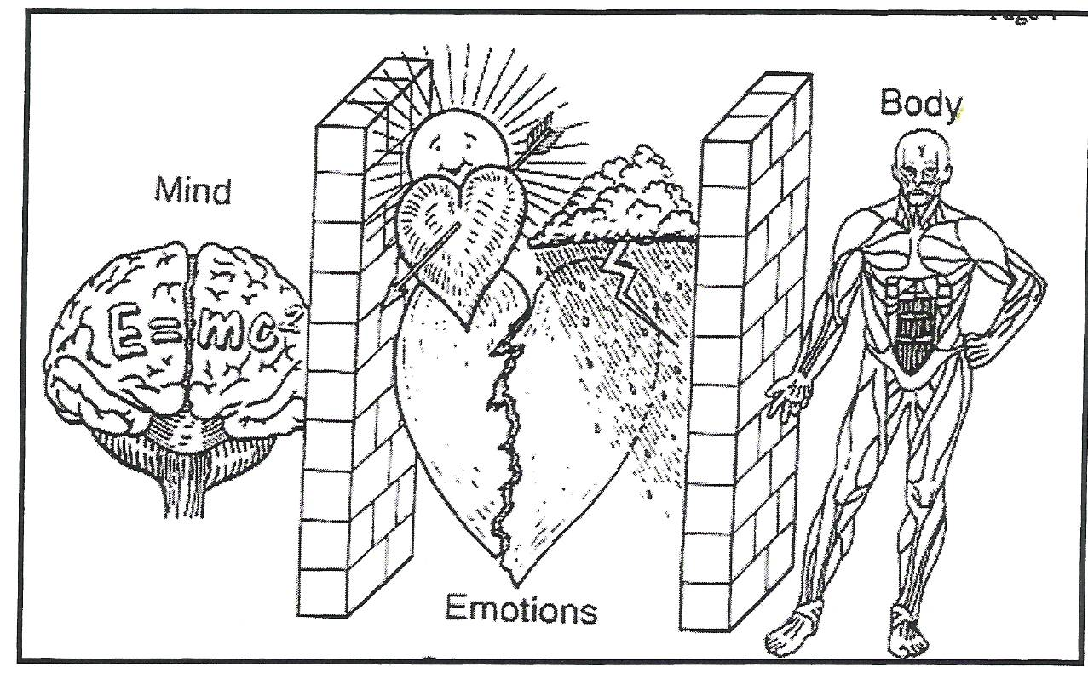
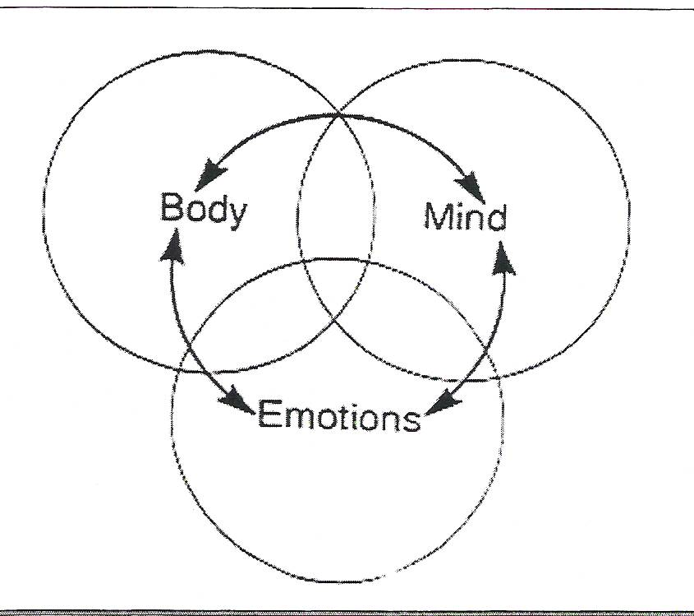
Rule# 8- All Learning is Mind-Body
NEW VIEW OF LEARNING
OLD VIEW OF LEARNING
Notes:
Old view of learning. We cannot separate the mind form the body. As discussed before, our emotions filter all experience to help us choose what is and is not important.

Slide 40
Movement Wires the Brain
The brain is the only organ that shapes the internal structure based on movement in the outside world.
Movement is critical to learning.
Procedural Memory systems more powerful with better storage and retrieval than semantic systems
Sitting still and being quiet may not be brain appropriate for learning
All learning is evidenced by movement. How do you show what you know? Do you just sit there ? Writing answers on test is motor function!
Notes:
Think about something you have learned. How did you know what you learned or how did others tell you they knew you learned something? For example, in school students, write, draw, role play, collect artifacts for a portfolio to demonstrate learning. All of the activities to show what you know are physical actions, including thinking.

Slide 41
Rule #9- Cycles and Rhythms are
Important to Learning
The brain has natural ups and downs where learning is affected
Brain growth spurts precede skill development
3-5 years difference in brain maturation and no one is behind or gifted
Gender Matters- Boys lag behind girls in reading and social functions
Preschool classrooms that are overly movement restricted may shortchange boys
Boys are more likely to be expelled from preschool than girls and African-American and Hispanic boys get expelled the most!
Growth Spurt 2 - 4 Years | Auditory Speech, Frontal lobes link with Spinal Cord Motor Areas, Connection between
4.5 -7 years | Whole picture processing, image, movement, rhythm, emotion, intuition, outer speech, integrative thought
7 - 9 years | Details, linear processing, refined language elements, reading and writing skills, sports techniques, linear math
8 years | Fine motor development, social behavior and control, fine motor eye tracking and focus, corpus callosum begins in frontal lobes (Hannaford, 1991)
Notes:
One Growth Spurt for Left Brain is between 7 and 9 years of age. What develops: Reading processes, detail and linear processing/cognition, language refinements, skills development in sports, liner math processing
The growth for the Right Brain is a bit earlier or 4.5-7years. What is developing then is whole picture processing, cognitive processes, image, movement, rhythm, emotion and intuition, outer speech and integrative thought.
The frontal Lobe undergoes a growth spurt at age 8 which helps skill development, development of inner speech, control of social behavior, fine motor eye movement for tracking during reading.

Slide 42
Timing is everything
The brain is poorly designed for rigid or “on task” learning
The brain needs a “timeout” to fix neural pathways
Age (Years) | Focused Learning (Minutes) | Rest Time (Minutes)
4-5 | 5-7 | 1
10-11 | 13-15 | 2
14-18 | 21-22 | 2
Adults | 21, 30, 45 blocks | 2, 3, 5 minute rest blocks
Notes:
Brains do not do well when they are forced to be on task. Children cannot be forced to attend or to be on ask.

Slide 43
Rule #10-Brains Need Food and Water to Learn
The brain’s only source of energy is glucose.
Excessive fat and protein causes the productions of many free radicals.
Free radicals may alter DNA
The human body is 70% water

Slide 44
What Can You Do?
Learn about developmental milestones so that your expectations are appropriate and do not trigger stress states-Teach them to others
Create non-stressful environments for children and babies
Remember that passive-aggressive behavior on the part of adults is still aggression
Children may not have well-developed (prosocial) response systems to threat so be flexible and kind
Use music to soothe and humor to change mood
Television is furniture
Touch is key to bonding and attachment- Hugs, appropriate kind and caring touches are critical to the development of children, especially the very young
If you witness aggression or poor caregiving and do nothing, you are apart of the problem. (Remember those mirror neurons!)
Courage is honed from tackling difficult problems, not easy ones!

Slide 45
Summary: Brain Rules for Caregiving
Children’s brains are unique
Children are born to be a part of a social group
Children’s brains are meaning driven
Cycles and rhythms of physical development affect all aspects of a child’s interactions with caregivers
There are at least two memory systems involved in learning
Brains need food and water to thrive (and behave)!
Emotions are critical to learning
The is a multi-pathway processor that can brain parts and wholes simultaneously in different modalities and is rarely over-stimulated
All learning is mind/body
Memory is dynamic and is created each time we recall an event. Apparently we store memory in many body cells.
The brain is highly adaptive and thrives on appropriate problem-solving opportunities
Stress, threats, and trauma alter brain functions and responses

