Slide 1
The Brain and Learning Language
Fundamentals!
The principal goal of education is to create people who are capable of doing new things, not simply of repeating what other generations have done—people who are creative, inventive, and discoverers.-Jean Piaget
Dr. Regina Rei Lamourelle
Dr. Seuss Project
PEACH
November 18, 2020
Notes:
I like this quote because it lets us know what is important and the reason. I enjoy so much sharing what I have learned about the brain with audiences like you. Learning, like love has no value unless it is shared. It is important that we, as educators recognize the value of the information available about how learning occurs, evaluate it, and incorporate what makes sense to you as an educator into your classroom practice. What makes no sense to me is that all of us have spent years in the classroom as either students or teachers and very few of us know anything about how the organ of learning functions. We may have studied pedagogy and course content in college, but very few teacher preparation programs have included information about the biology and physiology of learning. This situation is similar to doctors going to medical school to learning how to fix and recognize diseases but without a foundation in the anatomy and physiology of the human body. This evening, we are going to look at a bit of the underpinnings of the science behind what we think we now understand about the brain. I qualify this a bit since what we know about the brain has exploded since George Bush declared the nineties, the decade of the brain. Out of that political act, came thousands of research projects that have refuted some of the myths about what we assumed was going on in the brain as it applies to learning.

Slide 2
Brain Rules
1. UNIQUENESS- Brains and outcomes are unique. The brain is the only
organ where events shape the internal architecture
conditions in the outside world!
2. EXPERIENCES AND MOVEMENT- Experiences ( movement) wire the
brain. For efficient and quick responses, events that simultaneously will be
wired together. Use it or Lose it means that reinforced and used l
learning becomes permanent, otherwise, it may be pruned away.
3. STRESS AND THREATS- Threats, stress, and trauma may change the
physical architecture of the brain. The brain responds to threats with a
set of predictable neurobiological (physical), neuroendocrinological
(chemical), and neuropsychological (behavioral) changes.
4 RELATIONSHIPS MATTER!-Humans learn in the context of society,
family, and community.
5. PATTERNS AND MEANING- Brain cycles and rhythms affect learning.
Brains are masterful at creating and recognizing patterns and making
meaning.
6.19 SENSES-IMPLICIT AND EXPLICIT LEARNING- The body, brain, and
emotions are all intertwined shaping who we become. We learn through
the senses, all 19 of them!
7. Brains are always seeking meaningful relationships with events.
Notes:
These are some of the basic rules by which brains seem to operate based on the last few years of brain research. I cannot cover all of these here but, I do cover them in brain workshops. We will only have time for two or three but I will post the handouts on my website at drlamourelle.com where you can access them. Go to drlamourelle.com and on the workshops page access the workshops. The Login : brainyeducator Password neuron1293

Slide 3
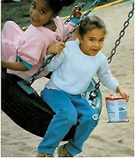
1. All Brains and Outcomes are Unique.
The brain is the only organ to shape itself based on what happens in the outside world. There are no two brains that are alike.
Outside events include events including time in the womb, home, school, community, world, and planet! Humans learn in the context of society, family, and community.
The brain is a biological marvel. It has more connections than all of the stars in the universe, and it is not identical to another brain!
For the educator teaching language, this means that using standardized or rigid, educational strategies that do not allow for the differences in brain age or organization may shortchange many students.
Rule #1- Uniqueness-.
Notes:
It has been said often but rarely thought about what it means to be unique. To show you the odds you beat on the journey to be you when you were conceived from one male and female gamete or sex cell there was a one in 64 trillion chance that you would be you! In the last billion-dollar lottery your odds of winning were 1 in 292 million. You had a greater chance of winning the lottery than being conceived! So that is one unique hurdle followed by many more such as.
The unique environment in your mother’s womb and her external environment further shaped your brain to become you. When you were born your experiences, what you did or did not do and how you were treated all became the master sculptors of the brain you have today. You, as educators of children, are sculpting brains. Uniqueness begins at the cellular level. No two brains are alike because no two humans occupy the same place simultaneously. Each person’s experience shapes the brain differently. Even identical womb mates do not have identical developing accommodations. Some are on top, some not. Position matters. Relationships are at the center of uniqueness. Placement in the family, time year born, and family resources all shape individuals differently. Let’s do an activity to see how unique you are.
HOW UNIQUE ARE YOU? WHAT DO YOU HEAR? Explain Paper folding activity

Slide 4
NEURONS WIRED WITH ACTIVE EXPERIENCES
ACTIVE EXPERIENCES
Cutting and Pasting Hands-on Activities Puzzles Problem Solving Problem Finding Pretend Play Braindough Brainstorming Finger Painting Dressing and Feeding self Assembling Toys Learning a new language Listening to Music
Growth Spurt: 2 to 4 years-
Plateau- 4 to 6 years
The child’s brain must hear sounds of language to properly wire components of speech. Language acquisition is Experience Dependent
Notes:
New , novel experiences facilitate myelination, which is what is needed for the impulses to be carried quickly along the axon body. New experiences cause the brain to make brain-derived nerve growth factors. These factors are instrumental in cementing new learning. BDNF are chemicals that facilitate the storage of new information. Movement of the large muscles such as legs for walking and running and arms and hands for picking up and moving to facilitate the release of the learning chemicals. There is little learning in the comfort zone. Educators are accustomed to standardized, benchmarks, quietness, control and avoiding chaos. I have heard on one instructor say in the course of my four girl’s education say something like You today was wild. The kids were so hyped up they were just trying so many new things. One group made a real mess but they learned you can’t put that much vinegar on such a small space without being prepared for the lava mess. I t took teamwork thought to ge t that cleaned up before the principle saw this and that to Alex’s mom for being such a support. I had to defend this teacher when another parent arrived early and was appalled at the mess
Learning is hard, and not pleasant. Practicing is the process that unleashes the learning chemicals. Once you have practiced any skill, you can do it automatically. Then this is learned
The child’s entire body and brain must be ready to learn. For example, toilet learning cannot be completed until the spine is myelinated past the nerves that control the bladder. You can reflexively train a young child to be toilet-competent, but true learning cannot occur until the spine matures. Along with spinal maturation is the myelination of brain areas controlling the body functions and the cognitive process of understanding what to do. Another example is sitting still in circle time. This is difficult for young children because the corpus callosum, a large bridge of white matter connecting the left and right hemispheres, is not yet myelinated. Myelination and lateralization are complete for this skill around 10-12.occurs during a brain growth spurt. There is a growth spurt between the ages of 2 and 4.The auditory speech sound system ushers in a growth spurt for increased language skills. The child’s brain must hear language sounds to properly wire components of speech. Language acquisition is Experience Dependent. During infancy as the brain matures by myelination of the area between speech comprehension and speech production , speech begins.
As the corpus callosum myelinates past the sensorimotor cortex improving coordination and planned movement and the spinal cord motor connections reach the frontal lobes. This means that a child can now understand what the fullness in the bladder means, and understand that they need to control release until they reach the toilet
(Brewer and Campbell, 1991)

Slide 5

LIMITED STIMULATION, DENDRITE PRUNING
The Cozy Canopy
Container Baby Syndrome (CBS) is when a baby or child spends most of their waking hours in equipment that limits movement and freedom to explore the environment. Movement ( pushing up, crawling, cruising, jumping aids in maturing reflexes. A “C” shaped container affects motor development (Abbott & Barlett (2001).
PRACTICES THAT LIMIT
Not allowing the child to dress self as stage-appropriate Not trying new things Insisting on silence and immobility Overuse of containers(swings, walkers, playpens, etc.). Messy play is frowned upon or forbidden. The child cannot play unsupervised as appropriate. Too much homework Outdoor play is forbidden Mistakes are punished. Free play is replaced with adult-supervised.
Notes:
This is a representation of what a neuron looks like with limited experience. Notice that there is little dendritic branching. Lack of stimulation causes the dendrites to shrink, whither, and be pruned away. Any unused neuronal system will be subject to pruning as a housekeeping measure. Skills learned as young children become strengthened if practiced but will wither if not. The behavioral fluctuations of adolescents are in part due to the natural pruning and refining of brain networks that are characteristic of adolescence. Genie, not her real name, but the one assigned to her is a tragic reminder of this phenomenon. She was discovered at 13 in Altadena, CA strapped to a potty chair. Her language was severely delayed, and it was evident that she had spent her language formation years without being spoken to or cared about as nature expects. As a result, many of her language networks were pruned away even after expert care by noted linguists at UCLA. Genie never learned to speak properly and had issues with syntax and grammar. This case led scientists to understand that the brain must have language experiences that involve syntax and grammar during early childhood period or these networks are pruned away. Speaking to a child and having them speak back strengthens language acquisition. Listening to cassettes and other media does not have the same function for the human brain as contact with humans. Ask yourself what purpose does an artificial sucking device is for infants and toddlers? While most people are well-meaning and use this to soothe infants and fussy, maybe the goal is to understand what fussy children need instead of pacifying them. How can language explode during the language formation years of birth to age three if the child has an artificial sucking device attached? We want babies to be silent unless they are being born or recovering from drowning. If crying was not something they needed to do then why are they wired to cry? Our job is to figure out why babies cry, not to eradicate it. Also ask yourself, if you needed something do you want to be pacified or understood? I think pacifiers used in moderation are fine and certainly putting children to sleep with a pacifier seems to protect from sudden infant death episodes, but when they are awake and should be crying, talking, eating and such, the pacifier may not be the best option. Look at this picture, If the brain is the only organ wired by experience in the outside world and if the sense organs need the experience to develop properly, think about how children kept in these kinds of containers may have compromised development. Just because something looks comfortable and cute does not mean it is appropriate for development. The ears need to hear sound from all directions to develop the tonographic map. While this looks “safe” babies need to see for vision to develop properly and the immune systems need to have reasonable challenges to develop.
Racelighting is “the process whereby people of color question their own thoughts and actions due to systematically delivered racialized messages that make them second-guess their own lived experiences and realities with racism.” Racelighting is distinguished from gaslighting when the messages used to invalidate the victim are racialized in nature. Ultimately, these messages lead Black, Indigenous, and People of Color to question themselves.
Most often, racelighting includes messages that reinforce stereotypes that people of color are academically inferior, have lower capabilities, are morally destitute, and are of lesser worth; however, unlike gaslighting, where the messages are intentional, racelighting messages can be intentional and unintentional, depending on the perpetrator(s) (Wood & Harris III, 2021
GROWTH SPURT TWO FOUR YEARS
The auditory speech sound system ushers a growth spurt for increased language skills.
Frontal Lobe links with spinal motor connections
The area between speech comprehension and speech production myelinates.
Corpus callosum myelinates past the sensorimotor cortex improving coordination and planned movement
Spinal cord motor connections reach the frontal lobes. (Brewer and Campbell, 1991)
PLATEAU FOUR TO SIX YEARS

Slide 6
ABOUT LEARNING?
Learning is a biological process that requires practice
Implications for Educators
Testing may be too soon. Learning takes time.
Practice time to learning is variable from a few seconds to three weeks+
Emotion Matter (adrenaline-cortisol mediated) charged learning tends to speed up retrieval and storage
Survival-mediated events and novel ones tend to get the most brain attention because adrenaline makes this event easy for the brain to view as important (survival related)and to take action.
Music, motor activity, rituals, dramatic play, and celebrations are ways to create novelty to speed up this process.
Notes:
Learning whether it is a language or anything else is a biological process that requires practice. It requires physical action and effort. Contrary to our socialization confusion, messy, disordered events, events some chaotic, are not always necessarily bad for learning. The brain need a time out to lean, these events provide this break. Also, these event provide the energy for problem.

Slide 7
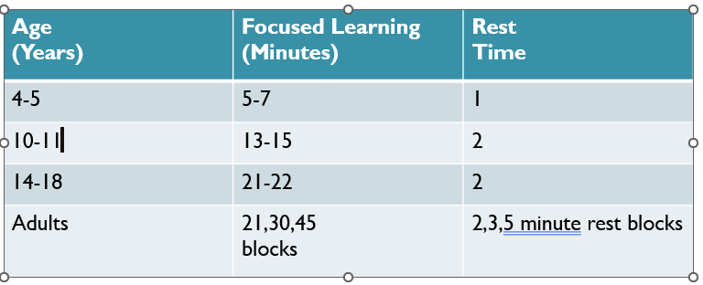
Timeout to Myelinate
Timing is everything
The brain is poorly designed for rigid /“on-task” learning
The brain needs a “timeout” to myelinate neural pathways
Testing may be too soon if new pathways have not yet sufficiently myelinated to facilitate retrieval of learned material, or if new information is introduced on an immature or stressed system.
Examples that show myelination has occurred!
Reading a book, toileting, eating, sitting, walking, and playing with a Frisbee, are all examples of myelinated learning networks that are hardwired because of the number of similar actions that have occurred over time.
TWO-FOUR–SIX-EIGHT TIME OUT TO MYELINATE!
Notes:
Learning is a physical process. New brain connections require the myelination of neurons in a particular learning circuit. If they are wired together, they will fire together making it easier for us to learn groups of like or similar information. The brain needs a rest period to complete the process of myelination and storage. We cannot use the same networks and store new information simultaneously. The brain requires downtime from a few seconds to minutes to complete this process. We sometimes have a cultural bias against rest and relaxation, unlike other cultures that factor this into their workday. We have glamourized people who work long hours and rest just a few. For some, this may be appropriate, but for most of us, rest is needed for the brain to tidy up networks and complete myelination. This is especially true for young learners. After interviewing a noted neuroscientist about sleep, the number one thing recommend to students to do well is to get a good night’s sleep. This is more valuable in long-term school success than cramming.
Each lesson should have a time-out to myelinate plan. Myelinated brains cells grow and connect to other dendrites making a rich network of opportunities. When a child’s brain does not have the appropriate experiences, the dendrites wither and may be pruned away.

Slide 8
EXPERIENCES- Doing the Math. . .
Children may view 5 anti-social acts (hitting, kicking, teasing, bullying, murders, battery, sexual violence, intimidation, name-calling, racial stereotyping, etc.) while viewing some television programs for 30 minutes.
2 antisocial acts X 30 minutes X 2/hr X 5hr/day=300 antisocial acts per day
1,500acts/dayX365day/yr=109,500 acts/yr.
109,500 acts/yr. X 15yrs. =1,642,500 is the number of antisocial acts that children see by the time they are 18 years of age.
It seems reasonable that this amount of “experience” would affect how a child’s brain is organized. We see some anecdotal evidence of this all the time with the change in level and kind of teen violence and acceptance complacency of horrible events by the public.

Slide 9
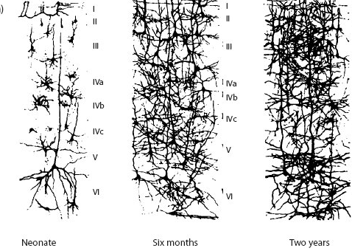
How Experience Changes Dendrite Density
MULTILANGUAGE LEARNERS-Learning more than one language increases the dendritic density for those operations. Multilingualism has been associated with better school performance and a brain with more connections that fares well in old age. For children, this can include sign language as infants, which provides a way for children to be understood while their other language systems are developing.
Notes:
This is a visual representation of what it looks like in terms of neuronal density. Babies are born with 100 million networks waiting for life experiences to hook up and organize into learning and behavioral networks. As time goes on a baby gets more experience which increases the dendritic branching and connections. This continues to accelerate until puberty when there is a developmental pruning of networks that have not been used. This is a normal process making the brain more efficient.
One of the earliest examples of the value of experience in helping these networks to form is eyesight./ This is the least developed sense at birth. Babies do not need to see in the womb. At birth, the vision clock is ticking. Babies need exposure to light for the visual system in the brain to wire properly. If vision is obstructed by newborn cataracts and they are not removed promptly, in a few months the brain will
prune away the connections needed for sight. This is why a newborn vision screening is done to catch those infants who have newborn cataracts so they can be removed immediately.

Slide 10
The Word GAP EXPERIENCE Controversy
There is controversy around the reported 30-million-word Gap between poor and rich children. Research from Stanford University suggests that the word gap begins with an attention gap which is a direct result of words heard. Poor children spend less time looking at familiar objects than more advantaged peers because they hear fewer words per hour than same-aged peers. They have a word experience gap which translates into a reported reading lag in later years.
However, this is framed in the context of a white, Anglo- American culture. Many children have not had the cultural upbringing experience that would assist them in performing as expected. This does not mean they are deficient in language expression, vocabulary, or communication in ways, meaningful to their upbringing.
It means they are evaluated using language and expectations that were not a part of their upbringing. Teachers should broaden their expectations and factor in the influence of culture and SES. They can intentionally add the experiences “missed” using what they have learned about the home culture and language as a guide. Missed is not used to be deficient rather, just an indication that the information was or was not included. Teachers can also ask parents for help in assessing what a child can do.
The point is, that we learn based on our experiences, but should we be judged as deficient because we have not had experiences that would lead to school-valued outcomes? These experiments are valuable because they highlight the difficulty in creating an educational assessment that only considers one set of values and outcomes as valid.
(Watch a two-minute video of the study at www.youtube.com/watch?v=I7HN5LJOc-w&feature=youtu.be.)
In this study, in words heard, the average child on welfare was having half as much experience per hour (616 words per hour) as the average working-class child (1,251 words per hour) and less than one-third that of the average child in a professional family (2,153 words per hour)” (Hart & Risley 2003, 8).
Notes:
2013).
The study, conducted by researchers at Stanford University, tested the language processing of 18- and 24-month-old toddlers using pictures, instructions, and eye response. Each toddler sat in her caregiver’s lap as images of two familiar objects were shown on a screen. (The caregiver wore sunglasses so the child could not be influenced by the caregiver’s responses to the questions or images.) A recorded voice identified one of the objects by name and used it in a sentence (Look at the doggy). The researchers filmed the child’s eye movements, tracking which picture the child looked at (vocabulary) and how long this took in milliseconds (processing time). (Watch a two-minute video of the study at www.youtube.com/watch?v=I7HN5LJOc-w&feature=youtu.be.) Children from higher economic backgrounds looked at the identified object faster and spent more time looking at the correct image. At 24 months, children from the lower economic group were performing at the same level as the 18-month-olds from the high economic group in both speed and accuracy. The study also focused on the way children process new vocabulary. Here, too, young children from homes with low incomes lag behind children of the same age who are growing up in more affluent circumstances (Snow 2013). The researchers at Sandford asked how fast can a child recognize a familiar word ?

Slide 11
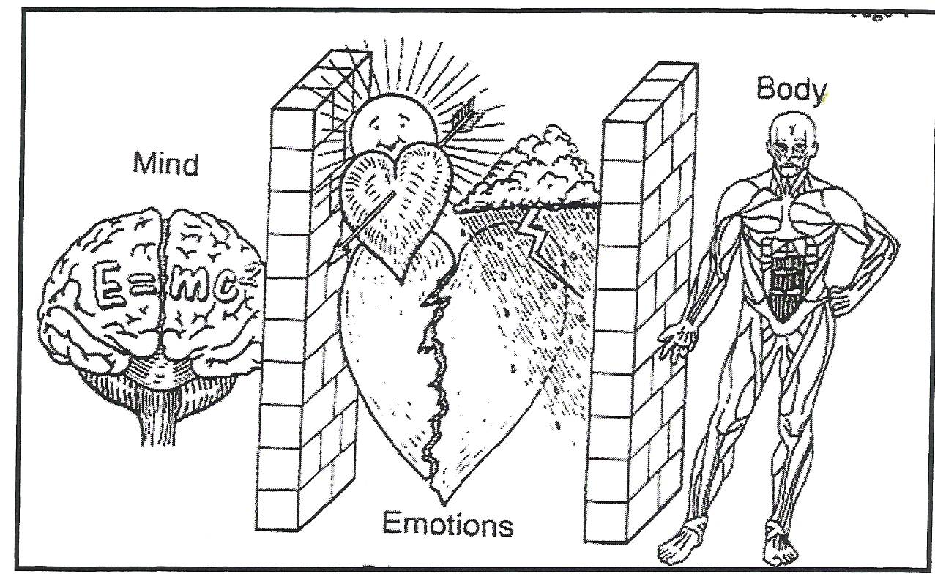
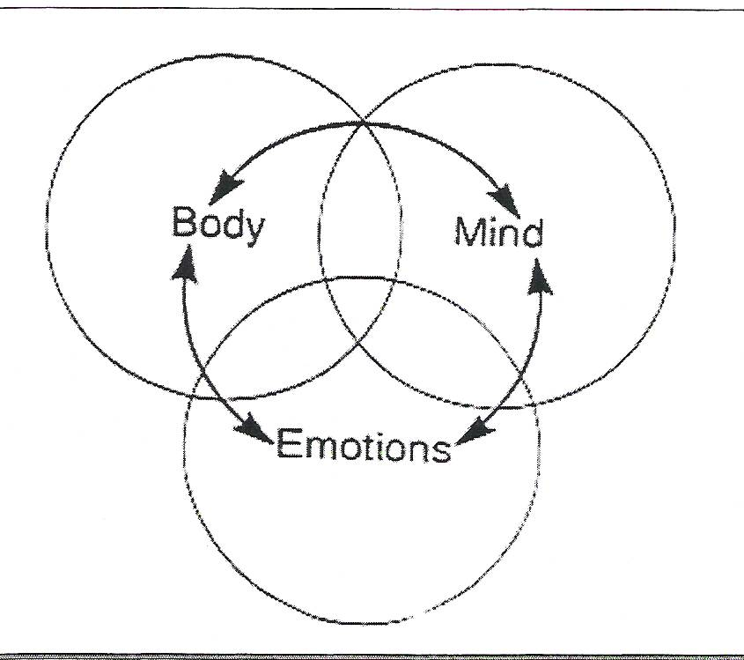
All Learning is Mind-Body
NEW VIEW OF LEARNING
OLD VIEW OF LEARNING
From 2 years through 6, learning is primarily linked to body movement.
  Aids in the release of brain-derived nerve growth factor (BDNF)
  Movement Elevates mood
  Movement increases oxygen to body cells
  Decreases blood cortisol
  Aids in myelination of body/brain areas
  Facilitates reflex development and integration
  Cause the release of brain-derived nerve growth factors ( NGF)
  Body/Brain connections are direct (auditory to the body, visual to the body).
According to Brewer & Campbell (1991), direct manipulation of objects and body movement is nearly impossible to stop at this age. Sensorimotor, visceral, and experimental learning is most appropriate during this learning cycle
Notes:
Old view of learning. We cannot separate the mind form the body. As discussed before, our emotions filter all experience to help us choose what is and is not important.

Slide 12
2. Movement Wires the Brain
Movement is critical to learning
Procedural Memory systems more powerful with better storage and retrieval than semantic systems
Container Baby Syndrome-Keeping babies and young children in “containers ( seats, playpens, swings, infant seats, classrooms vs outdoors)” prevents reflex development that can cause learning problems and reading difficulties. Dyslexia has been linked to a retained Moro reflex.
BRAIN RULE #2

Slide 13
3. Learning is Enhanced by Challenge and Reduced by Threats
Threats, stress, and trauma may change the physical architecture of
the brain. The brain responds to threats with a set of predictable
neurobiological (physical), neuroendocrinological (chemical), and
neuropsychological (behavioral) changes. According to Campbell and Campbell (1991), The child’s brain consumes more energy to be quiet and sit stills than during active learning exercises.
Brain Rule #3
Stress, threats, and trauma hijack the brain’s higher-order learning system(frontal lobe) in favor of the survival systems
(Limbic system-fight or flight)
Survival trumps Learning
Racial trauma and micro-aggressions are chronic stressors for children of color
Seat work, minimal group work, and lack of arts, music, and crafts, are stressful circumstances for most children.
Stress affects the growth of the brain and contributes to wiring for hypervigilance

Slide 14
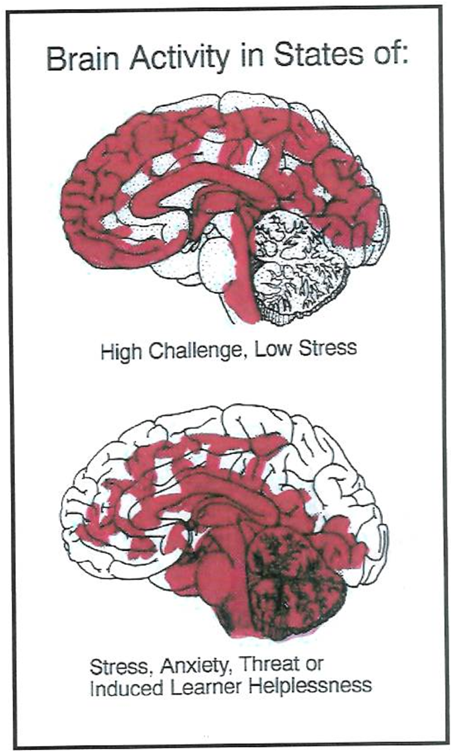
STRESS
Emotional Center hijacks the blood flow
Prefrontal cortex with adequate blood flow
Interrupts the process of memory
storage
Increases release of cortisol
Decreases the ability to use
executive functions (Self-
regulation, creativity, problem-
solving and impulse control)
Changes the physical architecture
of young brains
Creates impulsivity
Slows thinking and memory formation and retrieval
Prefrontal cortex with little blood flow
Notes:
Under stress the brain is biologically unable to store or retrieve memories or store new learning. The flight or flight system diverts the blood flow away from the frontal lobe to the survival system for quick action.

Slide 15
Defining Stress. . .
Stress can be misleading because some stress is needed to get things done. Too much stress is any biological event that causes that forces the normal physiological and neuro-physiological systems to function outside of their normal parameters. (Weinberger, DR, 2018)
African Americans and disadvantaged children may be more susceptible to toxic stress because of multiple adverse factors ( Smith, 2003) Racial Battle fatigue effects such as. racism, poor-quality schools, low access to health care, poverty, and so on are some of the major ways these groups are adversely affected. In addition, current generations of children carry the effects of toxic stress from their ancestors' genomes. Toxic stress changes shorten telomeres and change the expression of vital genes including brain-derived nerve growth factor. ( Asok, A., Bernard, K., Rosen, JB., Dozier, M.,& Rothe, TL(2014) The Last administration’s removal of children from their families created a level of stress that will be written on the brain and genome of generations of children.
Notes:
. During survival events, the brain’s rules are basic. The object is to survive and neutralize the life-threatening situation or event. For survival, actions precede thinking! The flight or fight hormones released in the brain trigger a sequela of biochemical events that lead to fighting or flight, survival, and actions. Thus, survival always trumps reasoned, logical thought. Suppose the stress is caused by a member of an out-group, the normal stress response proceeds. When someone is stressed, the reflexive response bypasses the more deliberative frontal cortex reasoning center and permits a person to make decisions based on deeply held stereotypes and beliefs. In-group affiliations activate the dorsal medial prefrontal cortex while the out-group triggers the ventromedial prefrontal cortex ( Mitchell, JP, Macrae, CN., & Banaji, MR, 2006).
Racial Battle Fatigue (RBF) was a term coined in 2003 by social psychologist Dr. William Smith; it was originally used in reference to the experiences of African American men in America but is now expanded to describe the negative and racially charged experiences of all people of Color (PoC’s) in the United States.
Racial Battle Fatigue: What is it and What are the Symptoms? Morgan Taylor Goodwin -https://medium.com/racial-battle-fatigue/racial-battle-fatigue-what-is-it-and-what-are-the-symptoms-84f79f49ee1e
Defining racial battle fatigue, what causes it, and what are the symptoms. Racial Battle Fatigue (RBF) was a term coined in 2003 by social psychologist Dr. William Smith; it was originally used in reference to the experiences of African American men in America but is now expanded to describe the negative and racially charged experiences of all people of Color (PoC’s) in the United States.
William defines racial battle fatigue as“cumulative result of a natural race-related stress response to distressing mental and emotional conditions. These conditions emerged from constantly facing racially dismissive, demeaning, insensitive and/or hostile racial environments and individuals.”
Smith decribed RBF as a “public health and mental health illness”. Smith believes that racial battle fatigue stems from racism and microaggressions, and in order to view these acts in today’s society
“. . . one must not look for the gross and obvious. But the subtle, cumulative miniassault is the substance of today’s racism”
Racial microaggressions are a form of psychological warfare and are defined as:
1) subtle verbal and nonverbal insults directed at people of Color, often automatically or unconsciously
2) layered insults, based on one’s race, gender, class, sexuality, language, immigration status, phenotype, accent, or surname
3) cumulative insults, which cause unnecessary stress to people of Color while privileging whites.
People of Color experience daily battles of attempting to deflect racism, stereotypes, and discrimination in predominately white spaces and must always be on guard or weary of the next attack they may face.
Racial Battle Fatigue causes people of Color to experience various forms of mental, emotional, and physical strain which can lead to psychophysiological symptoms. Symptoms of RBF are suppressed immunity and increased sickness, tension headaches, trembling and jumpiness, chronic pain in healed injuries, elevated blood pressure, and a pounding heartbeat. And when people of Color with RBF anticipate racially motivated conflicts, they may experience rapid breathing, an upset stomach, or frequent diarrhea/urination.
Other possible symptoms are constant anxiety, ulcers, increased swearing or complaining, insomnia or stress/anxiety dreams, rapid mood swings, difficulty thinking or speaking coherently, and emotional and social withdrawal in response to racial microaggressions or while in environments of mundane racial stressors. These stressors can lead to long-term health issues and cause PoC’s to lose confidence in themselves and their self-worth.
Racism is often preserved as a personal threat/battle and after facing that threat/battle continuously in predominately white spaces, people of Color may experience RBF and are left mentally, physically, and emotionally drained. And when RBF goes untreated or dismissed this stress-related psychological and physiological disease can be lethal and can kill gradually and stealthily through hypertension and poor health attitudes and behaviors.
Trauma is the neuro-physiological, neuro-psychological and chemical events that were the adaptive responses brought on by stressors. This could be words, actions, environmental mishaps, internal struggles, etc. Chronic stress changes the physical architecture of the brain.

Slide 16
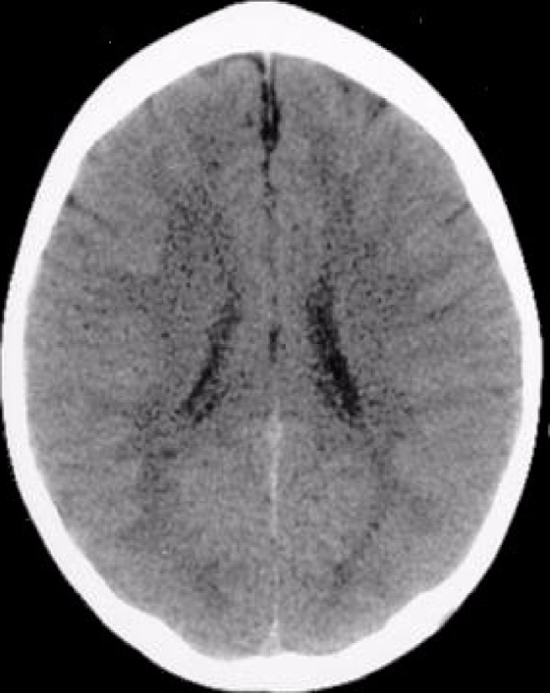
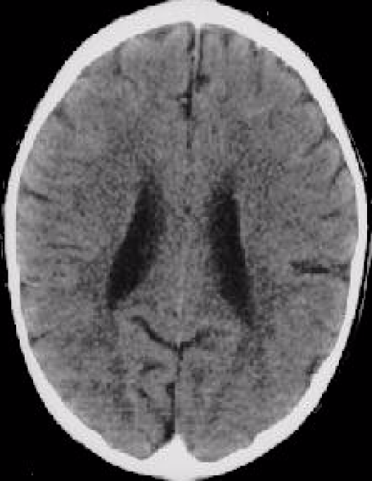
LIFE -LONG EFFECTS OF TRAUMA
N
O
R
M
A
L
B
R
A
I
N
ABNORMAL BRAIN
These images illustrate the negative impact of neglect on the developing brain. In the CT scan on the left is an image of a healthy three-year-old with average head size. The image on the right is from a three-year-old child suffering from severe sensory-deprivation neglect. This child’s brain is significantly smaller than average and has abnormal development of the cortex. These images are from studies conducted by a team of researchers from the Child Trauma Academy led by Bruce D. Perry, M.D., Ph.D.”

Slide 17
References
Bloomfield, M., McCutcheon, RA., Kempton, M., Freeman, T., & Howes, O.(2019). The effects of psychological stress on dopaminergic function and the acute stress response. eLife8:e46797. org, https://doi.org/10.7554/eLife.46797
Brewer, C.; Campbell, Don. G (1991). Rhythms of Learning, Zephyr Press : Tucson, AZ.
Colker, L. J (2014). The Word Gap: The Early Years Make a Difference. Teaching Young Children 7:(3), NAEYC.
Dryden, G. & Rose, C. (1991) Fundamentals Guidebook-The Building Blocks to Raise a Happier Child. Accelerated Learning Systems, Ltd.: Ashton Clinton, England.
Fernald, A., V.A. Marchman, & A. Weisleder. ( 2013). “SES Differences in Language Processing Skill and Vocabulary Are Evident at 18 Months.” Developmental Science 16 (2): 234–48.
Hannaford, C. (2011 ) The Dominance Factor. How Knowing Your Dominant Eye, Ear, Brain, Hand & Foot Can Improve Your Learning. Great River Books: Salt Lake City: Utah.
Hart, B., & T.R. Risley. (1995). Meaningful Differences in the Everyday Experience of Young American Children. Baltimore: Brookes.
Hart, B., & T.R. Risley. (2003). “The Early Catastrophe: The 30
Million Word Gap by Age 3.” American Educator 27 (1): 4– www.aft.org/pdfs/americaneducator/spring2003/TheEarlyCatastrophe.pdf.
Snow, K.( 2013). “New Research on Early Disparities: Focus onVocabulary and La
Weinberger, D.R.., 2018 & Roth. TL., Lubin., FD., Funk, AAJ., & Sweatt, D. Lasting epigenetic influence of early-life adversity on BDNF gene. Biological Psychiatry. 65(9) 1. Pp 760-769. doi: 10.1016/j.biopsych.2008.11.028 .
Asok, A., Bernard, K., Rosen, JB., Dozier, M. & Rothe, TL.(2014). Infant-caregiver experiences alter telomere length in the brain. PLoS ONE 9(7): e101437. doi:10. 1371/journal.pone.0101437

Slide 18

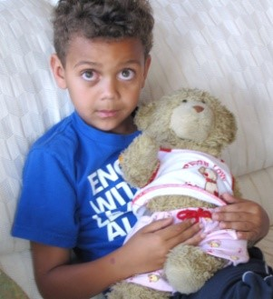
WHAT KIND OF BRAIN ARE YOU BUILDING
If a child is taught with criticism,
His brain learns to condemn.
If a child is taught with hostility,
Her brain learns to fight.
If a child is taught with fear,
His brain learns to be apprehensive.
If a child taught with pity,
Her brain learns to feel sorry for herself.
If a child is taught with ridicule,
His brain learns to be shy.
If a child is taught with jealousy,
Her brain learns to envy.
If a child is taught with shame,
His brain learns to feel guilty.
If a child is taught with stress,
Her brain learns to be on alert for an attack.
If a child is taught with forgiveness,
His brain learns to forgive.
If a child is taught with encouragement,
Her brain learns to feel confident.
If a child is taught with tolerance,
His brain learns to be patient.
If a child is taught that nothing matters,
Her brain learns to be helpless.
If a child is taught with appropriate praise,
His brain learns to be appreciative.
If a child is taught with acceptance,
Her brain learns to love.
If a child is taught with approval,
His brain learns to like himself.
If a child is taught with recognition,
Her brain learns that it is good to have goals.
If a child is taught with patience,
His brain learns delayed gratification.
If a child is taught with honesty and fairness,
Her brain learns what truth and justice mean.
His brain learns the meaning of generosity.
If a child is taught with security,
Her brain learns to have faith in herself and others.
If a child is taught with friendliness,
His brain learns that the world is a nice place to live.
If a child is taught with serenity,
Her brain learns to live with peace of mind.
If a child is taught to blame,
His brain learns to bully.
If a child is taught with indifference,
Her brain learns that education does not matter.
If a child is taught with intelligence and passion,
His brain learns that education is important to be successful.
What are you teaching the children in your care?
What kind of brains are you building?
Regina Rei Lamourelle©, 2013

