Slide 1

California Association for the Education of Young Children
Annual Conference
Pasadena, California
April 21, 2024
Brain Appropriate Strategies in
School-Age Settings
Regina Rei Lamourelle, Ed.D
Marianne Laney, MS
Sarah Shawesh, MA
Notes:
I really like this quote because it lets us know what is really important and he reason I enjoy so much sharing what I have learned about the brain with audiences like you. Learning, like love has no value unless it is shared. It is important that we, as educators recognize the value of the information available about how learning occurs, evaluate it and incorporate what makes sense to you as an educator into your classroom practice. What makes no sense to me is that all of us have spent years in the classroom as either students or teachers and very few of us know anything bout how the organ of learning functions. We may have studied pedagogy and course content in college but very few teacher preparation programs have included information about the biology and physiology of learning. This situation is similar to doctors going to medical school to learning how to fix and recognize diseases but without a foundation in the anatomy and physiology of the human body. This evening, we are going to look at a bit of the underpinnings of the science behind what we think we now understand about the brain. I qualify this a bit since what we know about the brain has exploded since George Bush declared the nineties, the decade of the brain. Out of that political act, came thousands of research projects that have refuted some of the myths about what we assumed was going on in the brain as it applies to learning.

Slide 2
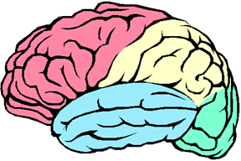
HouseKeeping
We are happy to SHARE!
You have access to these slides in the Conference Website / APP
We invite further conversations and collaborations! Please contact us after the conference!
lamourelle_regina@sccollege.edu
laney_marianne@sccollege.edu
shawesh_sarah@sccollege.edu

Slide 3
Food for Thought:
The brain is the only organ
to shape itself based on what happens in the outside world

Slide 4
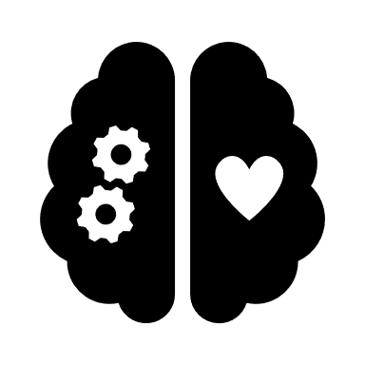
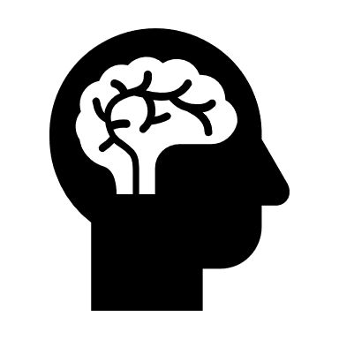


SesSion Objectives
Practical
Classroom Strategies
The Body/Brain
Connection
Stress, Trauma & the Brain

Slide 5
WHAT IS TRUE?
TRue oR False?
The brain is static and unchanging
We only use 10% of our brains
The period from 0-3 years is the most important learning period
Quiet and controlled environments work best for learning
We are either right-or left-brained
Individual brains are uniquely different
Practice make perfect
Male and Female brains are opposite each other
Students pay attention by looking at the teacher
You do not have to understand how the brain operates to become an educator in charge of a child's learning

Slide 6
According to Neuroscience:
It has long been understood as a consequence of evolution, the brain has modes of function that are natural and effortless. Understanding brain operating principles can help caregivers utilize the power of this tremendous organ.
Coerced to operate and interact against natural maturation and developmental timetables, the brain functions with a abundant error (1983).
Crime, poverty, learning disabilities, misbehaviors, child abuse, inattention, anxiety, and all social interactions reflect brain function.
How can the puzzle of interaction be unraveled without more knowledge of what shapes the brain and how the brain shapes us?
-Leslie Hart

Slide 7
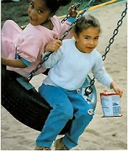
Rule #1- Uniqueness
Perspective Taking
There are no two brains that are alike.
Your brain is a biological marvel. It has more connections that all of the stars in the universe and it is not identical to another brain!
For the educator, this means that using standardized or rigid, educational strategies that do not allow for the differences in brain organization may shortchange many students.
Source: R Lamourelle
Used with Permission
Notes:
This has been said so often that it is rarely thought about. What does this really mean when we refer to brain uniqueness. When we were conceived from one male and female gamete or sex cell there was a one in 64 trillion chance that you would turn out to be you. The environment in your mother’s womb and her external environment further shaped you to become you. When you were born your experiences, what you did or did not do and how you were treated all became the master sculptors of the brain you have today. You, as educators of children are sculpting brains. Let’s play a game to see how unique you are. (Paper Folding Game)

Slide 8
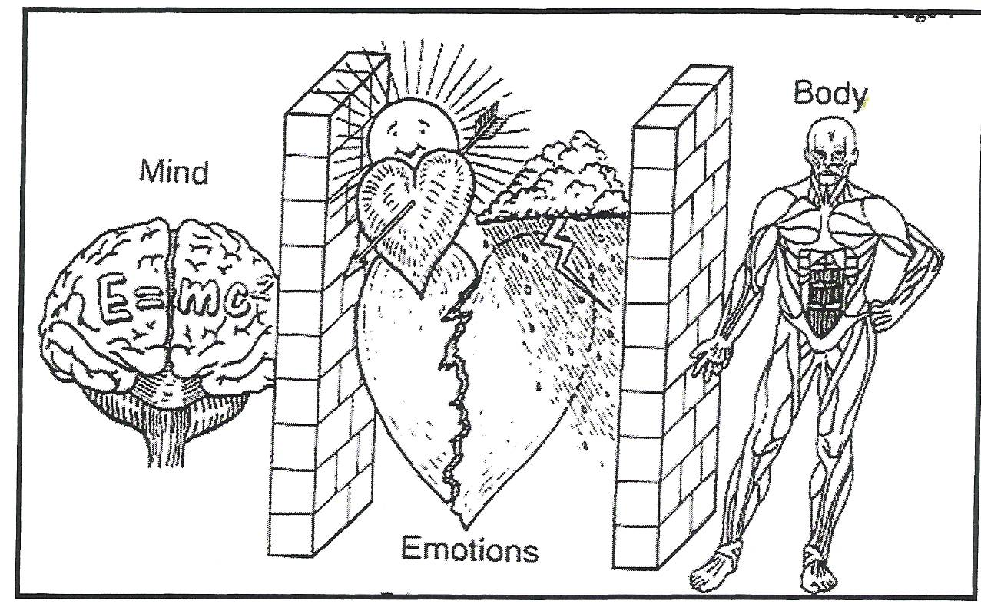
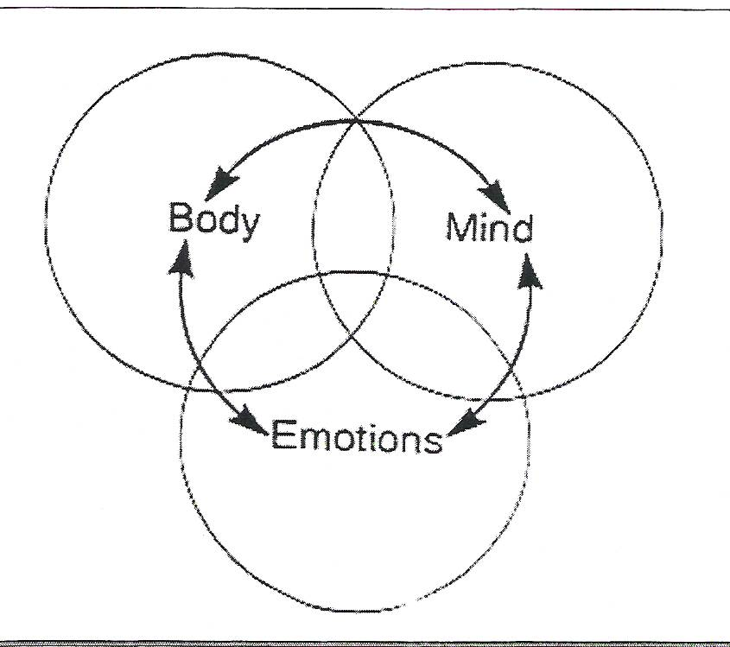
All Learning is Mind-Body
New Way of Learning
NEW VIEW OF LEARNING
OLD VIEW OF LEARNING
Source: the Brain Store
Notes:
Old view of learning. We cannot separate the mind form the body. As discussed before, our emotions filter all experience to help us choose what is and is not important.

Slide 9
Movement Wires the Brain
Brain Appropriate Strategy:
movement wires the brain
Movement is critical to learning
Sitting still and being quiet is not brain appropriate for learning
All learning is evidenced by movement.
How do you show what you know? Do you just sit there?
Writing answers on a test is motor function!

Slide 10
Uniqueness Prevails
Each brain is unique because it has been shaped by unique life experiences.
Experience includes, but is not limited, to everything a person has or has not done, seen, felt, reacted to, eaten, studied or not and places lived before and after birth.
Standards are meaningless for individual brains. Every brain needs an individualized education plan!
Source: Children's Discovery Center

Slide 11
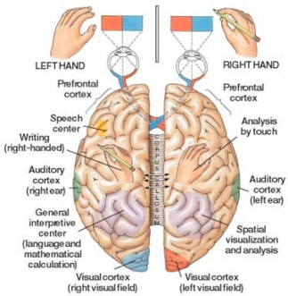
Unique Dominance Profiles
Education does not encourage holistic profiles
Education Institutions favor full access children who are linear processors (left brained, right eyed, right-handed, right-eared about 15% of the population)
The largest segment of the learning disabled group is global, right-brained, left-handed, left- footed, or a combination of these
According to Hannaford, ...My study also profiled teachers in the subjects schools. Full three out of four, 75% of them, were logic dominant, right-handed, right-eyed, and auditorially limited. Under stress, people with this profile tend to talk about details, not listen, and expect students to look at them!
Source: https://www.rightleftrightwrong.com/brain.html
​The largest segment of the gifted and talented population is the full access profile
Are we assessing giftedness or brain style preferences?
Notes:
Paper fold activity – intent; everyone heard the same instruction – our brain creates a unique meaning

Slide 12
Brain Appropriate Strategy:
Uniqueness triggered
Under stress, your dominant brain style takes over. This cannot be changed. Most effective brain styles do not have the eye dominance and brain dominance in the same hemisphere.
Right brain learners need to learn by moving, using music, emotion and be able to access intuitive understanding.
These children are the most affected by early academic pressure to read. Easel painting, dramatic play, music, and gestalt type learning have been devalued and removed from most Kindergartens .The strategies remaining favor left-brain children and linear learning

Slide 13
Active Illustration:
Example of
Cognitive Uniqueness
(Choose one piece of paper)

Slide 14
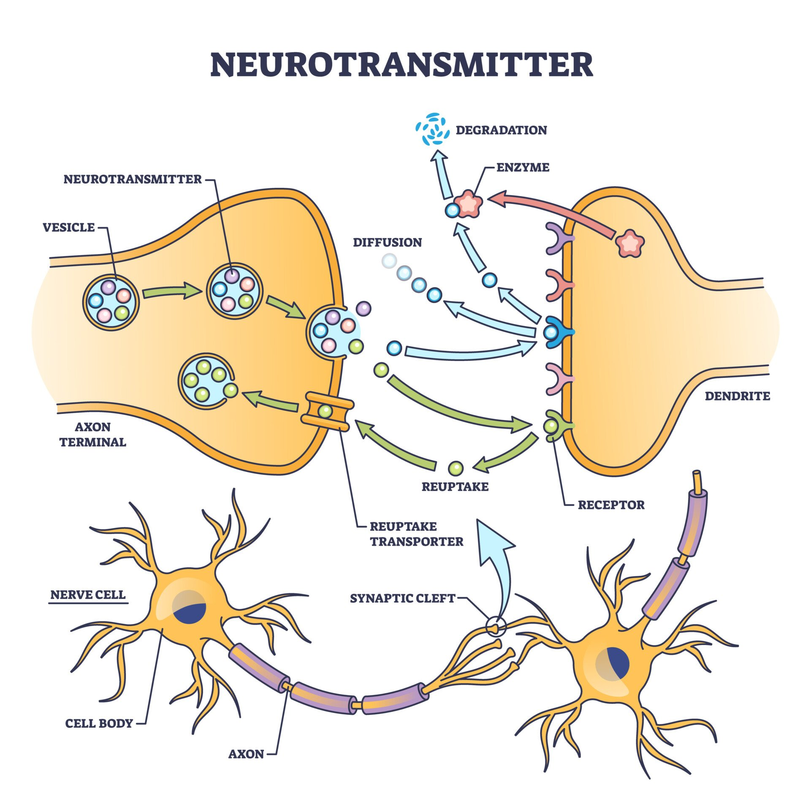
Brain Connections & Learning
The receiving neuron takes the neurotransmitter from the synapse and translates it into an electrochemical signal to send down to another axon and start the process all over again.
The axon sends electro-chemical messages (neurotransmitters) to the dendrites. The dendrites receive the messages in coves or gaps that are called synapses.
Source: Psychology Today

Slide 15
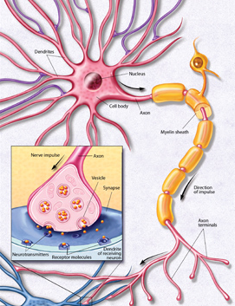
Brain Connections & Learning
Learning is the process of repeated firings and patterns of depolarization of these chemicals so that entire groups of brain cells respond automatically with little motivation.
Brain functions that wire together will happen automatically with minimal triggers.
A single neuron can connect to 10-15,000 thousand other neurons in this manner making for an efficient transfer of electro-chemical messages
Fatty Sheath Cover Speeds Nerve Transmission
When complete, the actions can be performed with less effort Learning has occurred when the information can be recalled easily
Source: https://www.brainfacts.org

Slide 16
Demonstration:
Example of
Electrical Connections

Slide 17
Brain Appropriate Strategy:
Utilizing Rhythms & Cycles
Brains operate on cycles and rhythms over the course of the day and throughout t​he years
The brain has natural ups and downs where learning is affected
Brain growth spurts precede skill development
3-5 years difference in brain maturation and no one is behind or gifted
Elementary classroom that are overly movement restricted may shortchange brain that need it
Brain is ready for at-4.5-7 | Whole picture processing, image, movement, rhythm, emotion, intuition, outer speech, integrative thought
7-9 years | Details, linear processing, refined language elements, reading and writing skills, sports techniques, linear math
8 years | Fine motor development, social behavior and control, fine motor eye tracking and focus (Hannaford, 1991)
Notes:
One Growth Spurt for Left Brain is between 7 and 9 years of age. What develops: Reading processes, detail and linear processing/cognition, language refinements, skills development in sports, liner math processing
The growth for the Right Brain is a bit earlier or 4.5-7years. What is developing then is whole picture processing, cognitive processes, image, movement, rhythm, emotion and intuition, outer speech and integrative thought.
The frontal Lobe undergoes a growth spurt at age 8 which helps skill development, development of inner speech, control of social behavior, fine motor eye movement for tracking during reading.

Slide 18
Brain Appropriate Strategy:
The brain needs rest
Timing is everything
The brain is poorly designed for rigid /“on task” learning
The brain needs a “timeout” to fix neural pathways
Age (Years) | Focused Learning (Minutes) | Rest Time
4-5 | 5-7 | 1
10-11 | 13-15 | 2
14-18 | 21-22 | 2
Adults | 21, 30, 45 blocks | 2, 3, 5-minute rest blocks

Slide 19
Brain Appropriate Strategy:
Planning for the Cycles
Do not test too soon. Myelination for new learning increases retrieval. Hook to carry learning are helpful. (Meaningful events, songs, powerful analogies or examples)
Survival mediated events and novel ones tend to get the most brain attention because it may threaten survival, moving it to the top of the list as important and take action.
Music, motor activity, rituals and celebrations are ways to create novelty for speeding up this process.
Movement causes the brain to release nerve growth factors that facilitate the myelination process we call learning
HYDRATE: Brains need water to properly function for learning and memory
Notes:
While a child is practicing a new skill or learning new knowledge, this process is occurring more slowly with more effort because these new networks need a fatty sheath of myelin to speed the transmission of the information. When myelination is complete, learning has occurred and the skill or information can easily be used or recalled.
Implications for Educators: Sometimes tests and evaluations are done too soon for individual children and their brain has not yet completed this process. It may take as little as a few seconds for survival impacted events to three weeks for less survival mediated events. This may be one reason why the more emotion and other senses used in learning new material, the easier it is for the brain to view this as important and take action. Music, motor activity, ritual and celebrations are ways to create novelty for speeding up this process.

Slide 20
Brain Appropriate Strategy:
Consider Multiple Senses
The Brain is a Multi-faceted processor!
The brain processes many different kinds of
sensory energy at the same time
Geo-gravimetric
Temperature
Eidetic Imagery
Magnetic
Infrared
Ionic
Proprioceptive
Sight
Taste
Hearing
Smell
Touch
Vomernasal
Ultraviolet
Proximal
Electrical
Pain
Balance
Vestibular
Barometric
Humans have
5 SENSE ORGANS
but at least
19 SENSES
Notes:
The brain can and does process many different kinds on information at one time. There are four brain lobes that process different kinds of information and integrate this information at nana speeds for action. When a child is asked to respond to a question in class, think a bout what discrete functions the brain has to manage at the same time. The eyes scan the scene for any threats to survival and for non-verbal content relevant to the questions. The ears must transmit discrete bits of sound to the auditory cortex in the temporal lobe for interpretation . Be fore that, the bits of sounds were evaluated in different parts of the brain depending on whether they were nouns, verbs etc. If you were a non native speaker, these operations may be located in different areas and the brain needs to find them. Meanwhile the parietal lobe is integrating the words and sounds together to formulate a response. The frontal lobe has been attentive to making meaning out of the questions and retrieving stored information that may be relevant to their response. He deep limbic systems must make sure that the appropriate emotional content is added and must also interpreted how the questions was asked and closely monitor threats. The hippocampus monitors the information and will be in charge of storing information in short term and alter long term memory. All this and more is happening at nano second speeds without conscious thought . Children with damage brain systems may not be able to encode and encode informational s rapidly as needed to make meaning and to respond.

Slide 21
Stress and the School age Child
Biological stress is any event that causes any event that forces the normal physiological and neuro-physiological systems to function outside of their normal parameters. (Perry, 2000)
Trauma is the neuro-physiological, neuro-psychological and chemical events that were the adaptive responses brought on by stressors.
This could be ANY percieved event, such as words, actions, environmental mishaps, internal struggles, etc.

Slide 22
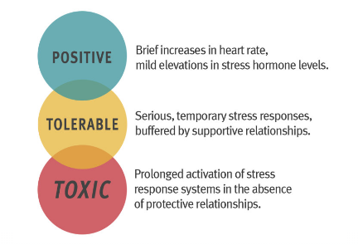
Types of Stress
Learning is enhanced by challenge
(tolerable stress)
and reduced by threats
(toxic Stress)
Source: Harvard Center for the Developing Child

Slide 23
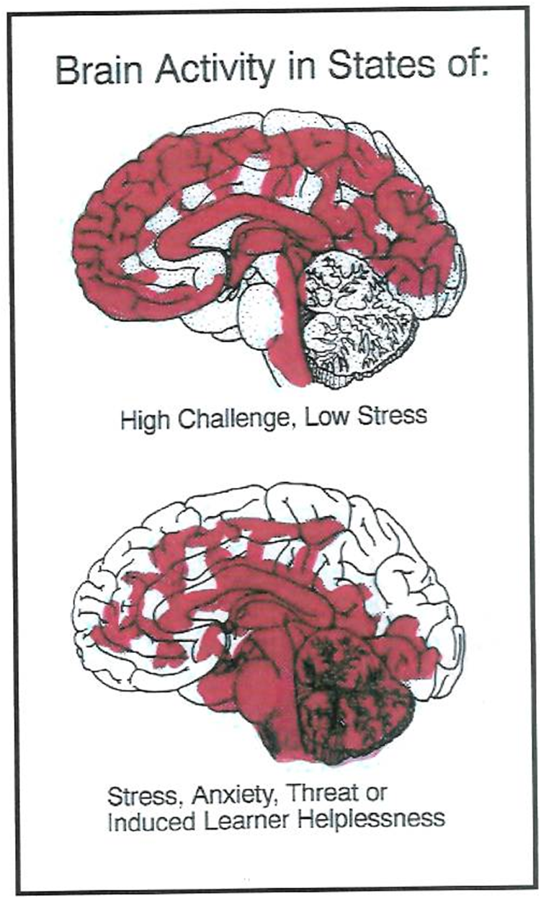
Brain Blood Flow During Stress
Calm Brain
Stressed Brain
Thinking Area-Prefrontal Cortex
Incoming Brain Signals
Calm
Emotional Center -
(Limbic System)
Stressed
Emotional Center
(Limbic System)
Incoming Brain Signals

Slide 24
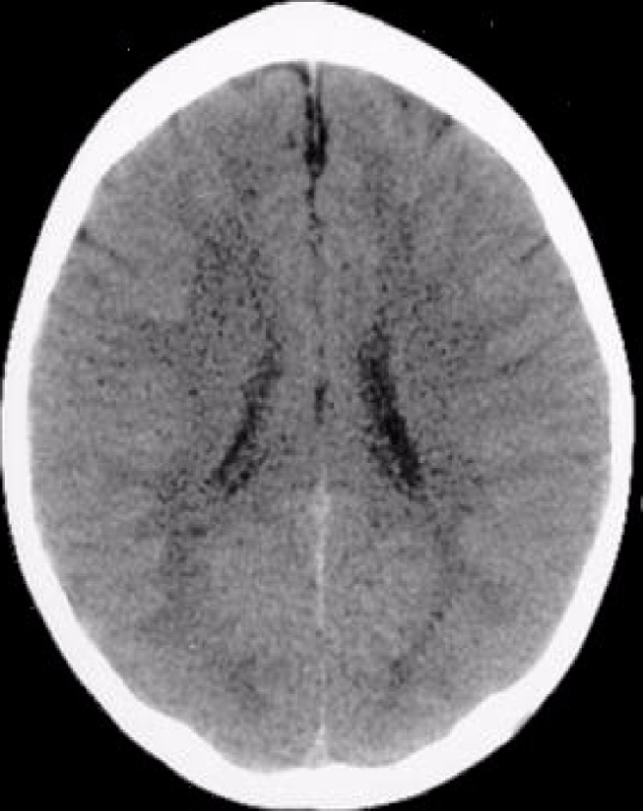
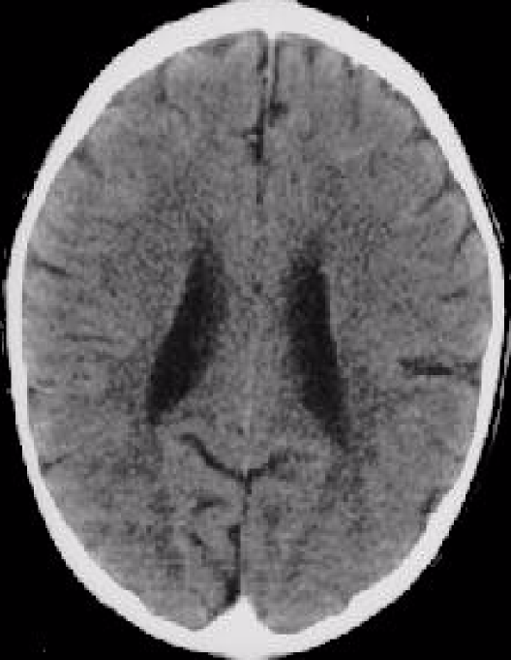
EFFECTS OF Understimulation
ABNORMAL BRAIN
Healthy
3-year old
Brain
3-year old
experiencing neglect
These images illustrate the negative impact of neglect on the developing brain. In the CT scan on the left is an image from a healthy three year old with an average head size. The image on the right is from a three year old child suffering from severe sensory-deprivation neglect. This child’s brain is significantly smaller than average and has abnormal development of cortex.”
“These images are from studies conducted by a team of researchers from the Child Trauma Academy led by Bruce D. Perry, M.D., Ph.D.”

Slide 25
Trauma Brain Vs. Learning Brain
Focused on survival & Hypervigilance
Cannot see the big picture
Normal events may be perceived as threats
Worry and blame predominate thinking
Learning new information is not a priority
Memory storage and retrieval are hampered
Executive functions decrease (self-regulation, creativity, problem-solving, and impulse control)
Body releases major amounts of stress hormones (Cortisol) that prepares the body for a fight or flight
Focuses on learning from novelty
Is calm and able to deal with ambiguity
Is hopeful and views actions as possible solutions to problems
Can deal with ambiguity
Learning becomes possible
Body releases some cortisol but other hormones and neurotransmitters involved in learning are released too
Executive functions are intact and are available to be used to solve problems, be creative, and control impulses
Normal pruning and refinement of learning networks proceeds normally
Notes:
Marianne

Slide 26
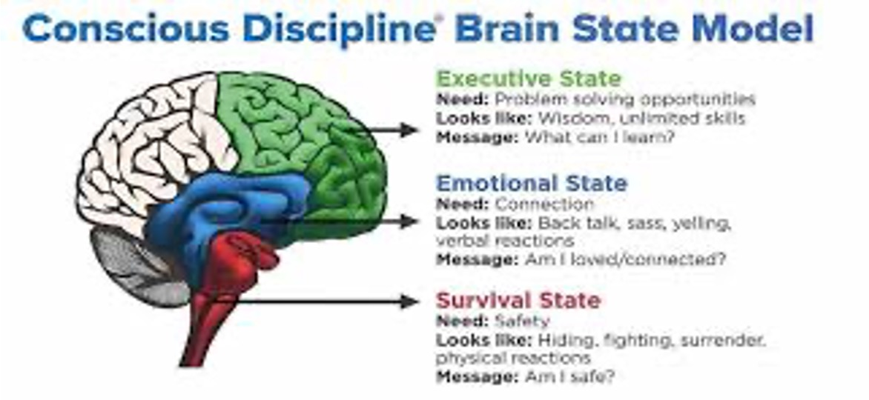
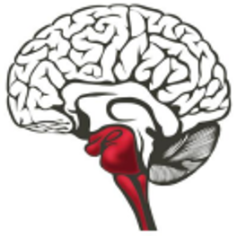
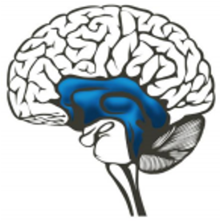
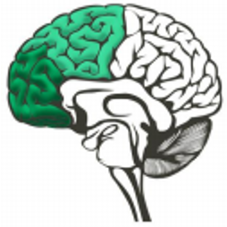
Brain state model

Slide 27
Making Meaning
“'Twas brillig, and the slithy toves
Did gyre and gimble in the wabe;
All mimsy were the borogoves,
And the mome wraths outgrabe"

Slide 28
Considerations
Automatization:
The development of a skill or habit to a point at which it
becomes routine and requires little if any conscious effort or
direction. (APA Dictionary)
Habituation: General, the process of growing accustomed to a situation or
Stimulus. The diminished effectiveness of a stimulus in eliciting a response, following repeated exposure to the stimulus. (APA Dictionary)

Slide 29
Brain Appropriate Strategies
Identify how you are creating safety in your classroom
Find ways to make learning playful or observe what children can learn through play
Plan body movement breaks
Use variable seating arrangements (Balls, couches, floor, etc.)
Do not restrict recess as a discipline measure
Use dramatic play techniques for learning
Use mind-mapping techniques
Use music and dance as learning tools
Strategies For the "Survival State" Brain

Slide 30
Brain Appropriate Strategies
Student choice and participation in meaningful decisions reduces stress. Enlist classroom attendees in making reasonable rules and consequences
Remember that “Mistakes” are fuel for learning and not an opportunity for punishment. Think about the unnecessary rules and deadlines that are arbitrary, punitive. and do not serve as a real teaching tool and minimize or discontinue them.
Assess other stressors in your classroom and remove them. (Too many displays, no music or creative projects, no place for children to go to be alone to think and be mindful)
Rituals soothe the stressed brain!
Create teams that can bond as a support group. The human brain is a social brain.
Understand and practice classroom management rather than control
Relax rigid deadlines that may be more child stressors than motivators
Practice mindfulness with calming jars. Student scan make their mindful jars at the beginning of school so that they have them when needed.
Symbolically release automatic negative thoughts and fears
Strategies For the "Emotional State" Brain

Slide 31
Brain Appropriate Strategies
Use hands-on learning wherever possible
Use a variety of learning examples using multiple intelligence strength information
Plan being there moments as much as is feasible
Bring back field trips and internships for older learners
Invite guests and other outside experts whenever feasible
Find ways to connect learning to the community. I participated in a project where the students interviewed community elders and created a biography for them. (English and History focus)
Write letters to advertisers or manufacturers complimenting their product or pointing out what else is needed (Girl got S. Curry to make shoes that appeal to girls)
Allow students to present major projects using their multiple intelligence strengths or personal preference
Make homework short and meaningful
Embrace interruptions as unplanned brain-break times
Strategies For the "Executive State" Brain

Slide 32
Reasons to be clearer
The brain searches through all of its information to find what makes sense.
The brain does not usually hunt for nonsense as this is not usually important for survival. We must consciously create nonsense.
One explanation why delusions are so powerful. People believe they are related to their survival or the survival of a loved one.

Slide 33
PFMFMRFP
Can you guess what this word is?

Slide 34
PFMFMRFP

Slide 35
The brain is meaning driven
The brain innately seeks meaning and to understand.
The search for meaning occurs through patterning.
The uses past information to interpret new information
This makes a good case for using prior learning or priming the learning apparatus.
The brain is run by patterns not facts. Televised media ingrains patterns that may be antisocial or untrue. The brain can’t help by make “patterns” or meaning of the volumes of data. Reports are that children watch 3-5 hours of television a day.
Notes:
The brain is meaning-driven and attention is secondary (use it 20% or less). We gain meaning three ways: by making patterns, using our emotions and finding relevance. The brain is poor at learning isolated facts without feelings or meaning. People learn best with information that is given in context, has a big picture and is relevant. This is especially true of work that is difficult and a child does not have the necessary pre-learning to make meaning of the new learning. Consider pre-learning like the rough draft of a paper. It is easier to refine a paper from a rough draft that to start from scratch to write a paper without the prior form. When houses are built, rough plumbing or pre-learning is installed before the final plumbing and fixtures are set.

Slide 36
Brain Bias
Our brains are also making meaning of why and how children are learning
Sometimes our brain attributes an action or behavior to the children's executive state, when it came from the survival or emotional state

Slide 37
Major Takeaways
SUMMING UP. . .
The brain is highly adaptive
All brains are meaning-driven
Cycles and rhythms of physical development affect all aspects of a child’s interactions with caregivers
Learning requires a confluence of the mind/body
Brains need food and water to thrive (and behave)!
      Emotions are critical to learning
Stress, threats, and trauma alter brain functions and responses
Supportive relationships are the best antidote to stress
Knowledge of the Brain State Model is crucial to effective learning
Safety in the classroom setting helps children regulate and learn more effectively

Slide 38
RESOURCES
Brenda Ingram, EdD, LCSW, Director of Clinical Services, Peace Over Violence. Brenda@peaceoverviolence.org
Helping Traumatized Children Learn. A Report and Policy Agenda. Retrieved at http://www.k12.wa.us/CompassionateSchools/pubdocs/HelpTraumatizedChi ldLearn.pdf
Trauma Informed Practices in Schools Children, Violence and Trauma—Interventions in Schools https://www.youtube.com/watch?v=49GzqPP7YYk
Modules on creating trauma informed care in schools, Madison Metropolitan School District. There are 10 modules, https://www.youtube.com/watch?v=elaLV_b8FXw • https://www.youtube.com/watch?v=lJpafA1G148 • https://www.youtube.com/watch?v=YQoQS4RFJRQ
Practicing Mindfulness https://blissfulkids.com/how-to-practice-mindfulness-with-children-the-essential-guide/

