Slide 1
Leadership and the brain
Chantal Lamourelle, MS. Santa Ana College
Regina Rei Lamourelle, Ed. D Santiago Canyon College
California Association for the Education of Young Children
Annual Conference April 19,, 2024

Slide 2
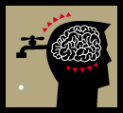
RULE#1-Each brain is unique
The brain is the only organ to shape itself based on what happens in the outside world. There are no two brains that are alike.
Your brain is a biological marvel. It has more connections that all of the stars in the universe and it is not identical to any other brain!
No two humans have the same brain structure
Each brain is designed by:
-unique chemicals
-heredity
-experiences
-hormonal balance
-sex & age.
Standards are meaningless to individual brains. On task or off task attitudes are meaningless.
Notes:
1. EACH BRAIN IS UNIQUE. No two humans have the same brain structure; not even identical twins who share the same heredity and fingerprints. Each brain is designed by individual chemicals, heredity, experiences, hormonal balance, sex & age. Standards are meaningless to individual brains. On task or off task attitudes are meaningless. Males and females approach team work and leadership differently and have brain strengths that are based on research, not politics.

Slide 3
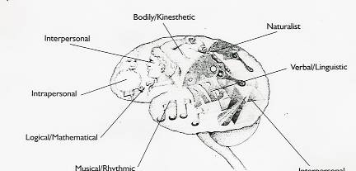
UNIQUE BRAIN TALENTS- MULTIPLE INTELLIGENCES
Intrapersonal
Bodily Kinesthetic
Naturalist
Verbal Linguistic
Logical Mathematical
Naturalist
Interpersonal
Musical
Existentialist
Interpersonal
People have unique combinations of talents and strengths. What are yours?
Notes:
According to David Sousa ( 2003), existentialist strength as defined by Gardner(2000) is the ‘ability to locate oneself with respect to the significance of life, the meaning of death, and the ultimate fate of the psychological and physical worlds we exist in.” Some of the brain areas involved in this strength are the frontal cortex, the somatosensory cortex and the limbic system. Ethical and moral dilemnas that educator must face have a place in the brain.

Slide 4
Brain gender and Leadership
Act impulsively and alert to photos of fearful faces
Smaller corpus callosum, fewer connections
Larger and faster growing hippocampus
Hypothalamus larger, about twice as large females (regulates mating behavior)
Males optical and visual fields need rely on movement
More areas dedicated to spatial-visual operations
Brain may shut down with long explanations or meetings
Testosterone rise may precipitate aggression and competitive behavior
Less impulsive
More interested in figuring out meaning of faces
Larger thicker corpus callosum with more connections
Smaller and slower growing hippocampus
Hypothalamus about half the size of males (regulates mating behavior)
Verbal and attentions areas are larger in females
Boredom leads to distractions and socializing to increase connecting in long meetings
Oxytocin and serotonin may cause withdrawal
emles Generally
MALES Generally
Females Generally
Neither brain is better than the other. Male and female brains evolved differently specializing in tasks and behaviors that aided the survival of our species. Many of these are coded in our genes and determine how certain portions of the brain will operate.

Slide 5
WAYS BIOLOGICAL GENDER MAY Affect Leadership
May perceive females as weak and nonassertive
More likely to want to dominate (win) and conquer (someone loses)
May not think adequately about the consequences of actions before acting
More likely to respond aggressively to any perceived threat to territory or threats to potential mates
May perceive overt actions as threatening and aggressive
Are more likely to mediate conflict to build consensus
Use more words
Less focused on threats, more connections for caring, empathy, and sympathy

Slide 6
Leadership Implications for the Uniqueness Principle:
1. Using standardized or rigid, strategies and policies that do not allow for the differences in brain organization may make it difficult for workers to perform or improve their performance. It also means that some expectations may be developmentally inappropriate for that person’s brain.
2. Culture, language, and differences in experience mean that there will be more than one speed or way to solve a problem to get things done
Difference does not mean deficit
4. Choose a diverse team of people with different strengths

Slide 7
:
5. As long as core principles are respected, be flexible in how individuals carry out their work
6. Practice doing different things to prime the brain for flexibility
7. Hire people who have innate strengths and traits for the job you need to be done.
8. Skills can be learned but it is more problematic to change personality and ways of being.
Notes:
LEADERSHIP APPLICATION: Some brains are better designed for certain tasks. Understand how to use a variety of assessment tools to decide if you are hiring the right brain for the right job. Each person will approach tasks and learning with a different set of values and rules. These are based on their past experience and must be honored as valid. Culture shape values and expectations and must be understood if work is to occur in harmony.

Slide 8
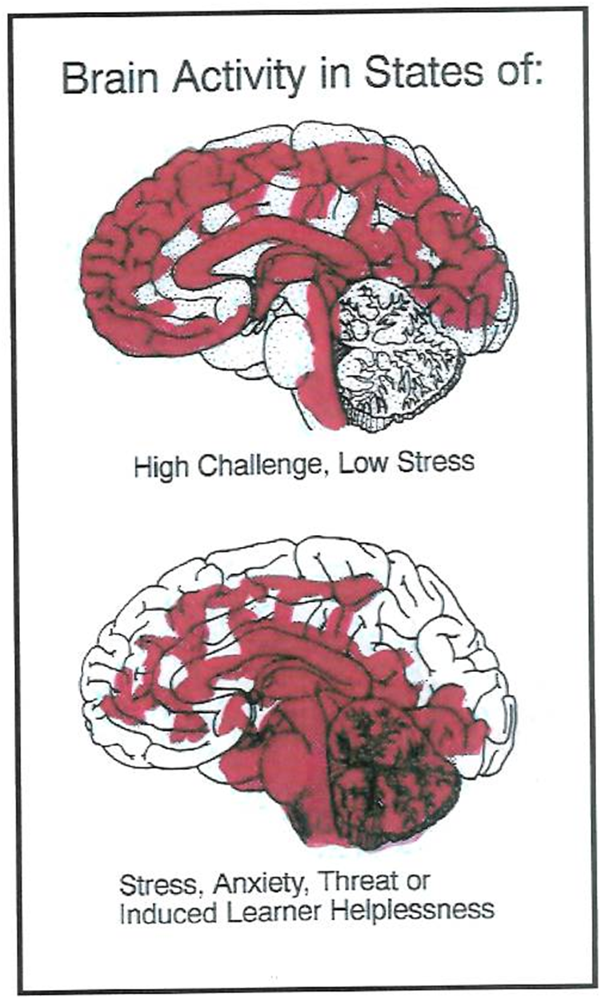
RULE #2: STRESS AND THREATS INHIBIT LEARNING
PFC
RAS
Normal State-
High Challenge, Low Threat
Abnormal State-
High Stress, High Threat,
Prolonged Stress:
Decreases ability to store learning
Decreases the ability of the immune system to fight off disease
Decreases the pre-frontal cortex functioning (thinking and decision-making)
Affects the brain and heart rhythms children and small animals in your care

Slide 9
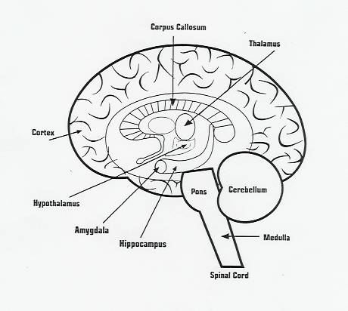
KEY STRESS BRAIN AREAS INVOLVED IN LEADERSHIP
Prefrontal Cortex- Executive Control Center
Reticular Activation System- Gate Keeper-Alerts brain to changes in environment
Thalmus - Routes information to appropriate brain area for processing
Amygdala- Emotional Alarm Center
Hypothalmus- Internal information regulation, relay for memories
Pons and Medulla-Basic life sustaining functions
Cerebellum- Balance, motor memory, new learning
Reticular Activation System
Basal Ganglia
Corpus Callosum- Connects right brain to left
Basal Ganglia- Regulate and terminate movement
Notes:
Prefrontal Cortex-Executive control center managing decision making, sorting and implementation strategy, problem finding and solving
Corpus Callosum- White matter connecting fibers that integrate information from right to left
Thalmus- Gatekeeper of all information coming into the brain except the sense of smell
Amygdala- Brain’s almond- shaped emotional alarm center. Catalogs and stores memories of high emotional content
Hypothalmus-Regulates hunger, thirst, sex drive , etc.
Basal Ganglia-Partially surround thalamus and regulate , initiate and terminate voluntary movement and emotion. Implicated in ADD, ADHD

Slide 10
Prolonged Stress. . .
-Decreases ability to store learning
-Decreases the ability of the immune system to fight off disease
-Punishment often results in high levels of cortisol
Cortisol blocks access to areas that store and retrieve knowledge
RAS begins the process that shuts the PFC down
Mistakes are misses (experiments) before the learning takes. RRLamourelle, 2009

Slide 11
Implications for leaders
What Happens
Behavior to expect
RAS-Acts like a toggle switch
Activated When… -
1. High Emotions and 2.Relaxation
Action 1: Terminate connections to cerebral cortex
Action2: Creativity and Logic possible
1. High Emotions:
Little rational thought or problem solving
On automatic pilot and trained behaviors predominate
2. Relaxation-Creativity and Logic connections re-established
Don't expect people to make tough decisions or solve complicated problems when they're stressed out. Take Sully Sullenberg, the pilot who landed a plane on the Hudson River as an example. He didn't have time to figure things out; he had to act fast using procedures he'd practiced many times before..
Notes:
The RAS acts like a toggle switch. In the cases of high emotion the toggle shut off the cerebral cortex so that highly complex behaviors like problem solving are no longer possible. When the body is relaxed and there is no threat, the toggle switches back on again allowing the creative and logic centers of the brain to be accessed . Leaders who constantly cajole, threaten, and create an environment of uncertainty and stress do not help the people around them make good decisions or solve problems. They may be more error prone because the brains focus is on survival and not on problem solving. The RAS has sensed which is a greater threat and responded. This is not a voluntary or conscious system..

Slide 12
UNUSUAL EVENT rehearsal-ROLE PLAY
Since the brain cannot problem-solve well under stress, leaders can…
Create emergency scripts of dialogue to solve issues
Practice high-stress situations and responses
Model appropriate responses for staff
Get more knowledge about child and brain development to know how to respond appropriately
Develop personal stress reduction techniques and pass them to staff
Practicing how to respond (rather than react) to emotionally challenging situations strengthens neural pathways, enabling leaders to manage events effectively.
Notes:
Leaders in ECE settings could rehearse responses to tense situations and teach these responses to others. We rehearse what to do in an emergency. Maybe we should rehearse what to say when a parent is angry about. . . When co-worker acts unprofessionally, and so on

Slide 13

Learned Behaviors
Humans Are Wired to Express
Humans Must Learn to Express
Empathy
Optimism
Sympathy
Humility
Forgiveness
Compassion
Patience
Shame
Cooperation
Sadness
Joy
Anger
Surprise
Fear
Disgust
People's brains are wired differently, so they show emotions in various ways. How we express emotions can be shaped by our upbringing, culture, and life experiences. Different cultures don't always react to sadness in the same way.
Notes:
We must learn to be prosocial. I could be that for most children environments are overly permissive, aggressive, etc. do not give children’s brains the variety of emotion to wire healthy prosocial behavior. I have to qualify this because we have all see and may know people who have terrible family situations but turn out to be caring, kind and prosocial. Since we learn to care, what is learning anyway.

Slide 14
EmOTIONS RUN THE BRAIN
EMOTIONAL STATES
Frustration/Worry/Concern
Anxiety/Tension
Satisfaction
Low-Moderate Stress
Excitement/Joy/Bliss
Optimism/Hope/Love
Disappointment
Discouragement
Rejection/Sadness/Grief
“Negative” states are normal emotional states too!
NO growth in the comfort zone.
Both positive and negative emotions are important for learning since all incoming information must pass through the emotional brain.
ALL Learning is affected by emotional states.
Leaders can leverage the understanding that emotions are integral to brain function to foster better communication, decision-making, and team dynamics.
Notes:
There is little growth in the comfort zone. Some challenge and stress are an in evitable part of the human experience and necessary for wiring a full range of emotional responses…

Slide 15
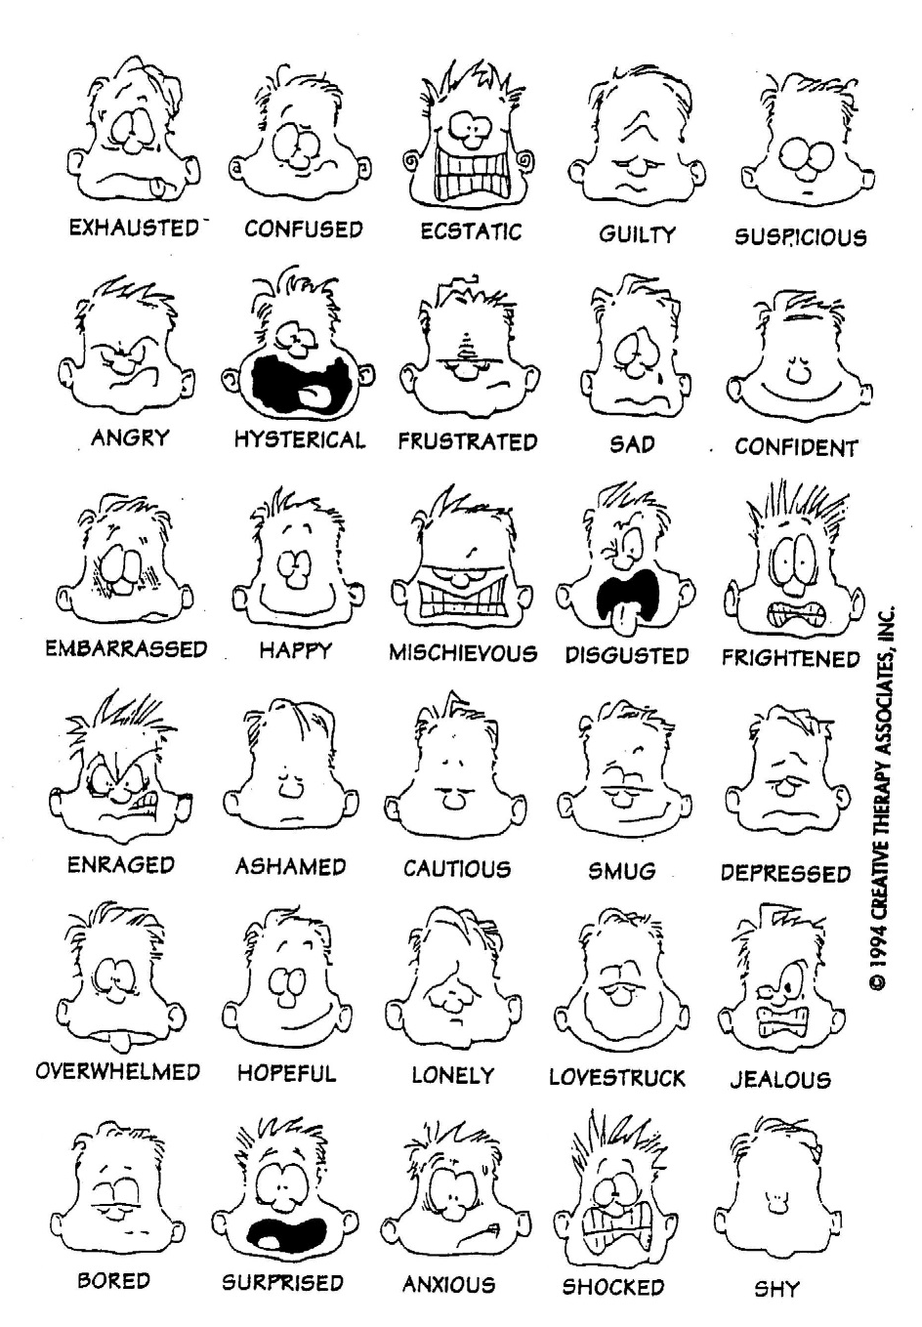
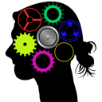
The Brain is Wired
for Negativity
Look at these expressions. How many of them are positive?
Why are humans wired this way?

Slide 16
“I Think, So I AM”
Experience and external influences include the negative self-talk we use.
Learning and habits shape the brain
Brain chemicals can be addictive
Negative thoughts and self-talk shape the brain and become the brain’s operating design
What you think changes how the brain is wired!
Experiences Wire the Brain!
Experience intricately shapes the wiring of the brain through dynamic processes of synaptic plasticity, whereby neural connections are strengthened or weakened in response to environmental stimuli and behavioral interactions.

Slide 17
What Species of A.N.T Do You Use Most?
A.N.T. -Automatic Negative Thoughts.
1. Your thoughts have power and influence how you feel.
2. Negative thoughts (I can’t…) make you feel bad
3. Good (I can…) thoughts make you
feel good
4. We can see these effects on brain scans and biofeedback devices.
Automatic negative thoughts possess the capacity to exert influence over one's actions, shaping behavioral responses and decision-making processes, thereby impacting overall cognitive functioning and emotional well-being.
Notes:
Dr. Daniel Amen speaks about the influence of our thoughts on our behaviors. Thoughts are energy that shape brains. Automatic Negative Thoughts affect how you brain functions. Our brains lie to us all the time and just because you think it does not make it rue. Some ANTs that hold you back from embracing solving new problems are:

Slide 18
5. Thoughts are automatic. They happen!
6. Thoughts can be dishonest, taunt, scare, tease, demean you, and reinforce antisocial behavior or perceived inadequacies.
7. Being “politically correct” by saying
what you can’t do or are not good at
backfires for building self-confidence
8. Your brain lies to you! Just because you think it, does not mean you have to believe it!
You can practice how to combat negative thoughts with positive or balanced thinking.
Source: Amen Clinics, Dr. Daniel Amen(2005) www.amenclinics.com
Replacing the automatic negative thought with a positive one can help shift focus towards constructive problem-solving and self-empowerment
"Your mind will take the shape of what you frequently hold in thought, for the human spirit is colored by such impressions”. Roman Philosopher, Marcus Aurelius"

Slide 19
Identifying the A.N.T. Species
Always Thinking | Thinking that something is absolute. EX: “I always get frustrated when”... “I will never be able to ”...” Alicia is always complaining”…
Mind Reading | Believing that you can read minds and know what others think or feel even if they have not spoken to you EX: “I am not liked because I do not use technology”… “My boss thinks I am stupid”… “She only did that to show us up.”
Fortune Telling | Predicting the worst possible scenario or outcome. EX: “I am not going to use a computer because it will crash and”. . . “I and not going to use email because it always wastes my time”. . . “Everyone will laugh at me because”. . . Oscar is acting out because he is jealous of his new sibling.
Labeling | Using negative labels for yourself or others use Ex: “Alicia will not be able to do this because”. . . “African American boys are more physically aggressive because. . . “I’m stupid”. . . Hispanic children will not perform as well as other because…
Blame | Blaming others or circumstances your difficulties. EX: “If they would just go back to the way things were, there would not these problems”. . . “I can’t learn to use a computer because I am poor and we do not have one at home.” I hate the way she makes me feel.
Thinking with Feelings | Believing all the negative self talk without challenge Ex: “I will never figure this out”… “I quit, this is just impossible to figure out”. . . “These instructions are stupid”
Focus on the Negative | Seeing only what is bad or wrong in a situation Ex: “See, I told you that the instructions were lousy” . . . “This won’t work. We have tried it before and it failed.” “They will never pay preschool teachers what they are worth.”
Guilt | Thinking in words like, should, must, ought to or have to Ex: “They should be doing”. . .”I ought to at least be able to”. . .”I shouldn’t have” . . .
Source: Amen Clinics, Dr. Daniel Amen(2005) www.amenclinics.com

Slide 20
Antidotes for A.N.T.S
Consciously Talk Back to Irrational Thoughts!
For Example:
A.N.T- Thinking in “always” or “never” terms
A.N.T. Response-: “I always get frustrated when I start
to learn how to use my computer”
Anti-ANT -RESPONSE-“I get frustrated when the children all crowd around me when we are getting ready to go outside. Usually, a fight begins, and then there is pushing and shoving.” I know that stress will prevent me from thinking clearly and managing the situation, so I am going to take it step-by-step and begin by being prepared and inviting a few children to get ready to go outside by holding our games, and others will get to choose our “going outside” song.
Practice makes Permanent . Over time, practicing responses to A.N.T.s will lay down brain pathways to solve problems differently.
Practice makes Permanent Consistent practice ingrains habits into our minds. By repeatedly practicing responses to Automatic Negative Thoughts (ANTs), individuals can gradually establish new neural pathways, enabling them to approach problems with alternative perspectives over time."

Slide 21
Other A.N.T. Killers. . .
Take action to improve skills
Speak to others and collaborate
Realize that new learning is not meant to be easy. There is no learning in the comfort zone!
Uncertain feelings, anxiety, and frustration are all normal emotional states that embody the energy for change.
Practice “can do” body positions
Drink water and exercise!
You have no idea what poor opinion I have of myself and how little I deserve it.
How do you measure up as a leader? Are you mentoring people to learn and use the learning appropriate states?
Notes:
We are less stress when we are in control of the situation. The teacher may accurately predict the stressful outcome but may not have the skill or expertise to know how to respond. The fact that the situation gets out of control is the opportunity for the professional educator to develop strategies to mitigate the negative impact on the routine and behavior. If you accurately predict that there is going to be an issue that, the appropriate response is to take action by preparation nd information to mitigate the damages.

Slide 22
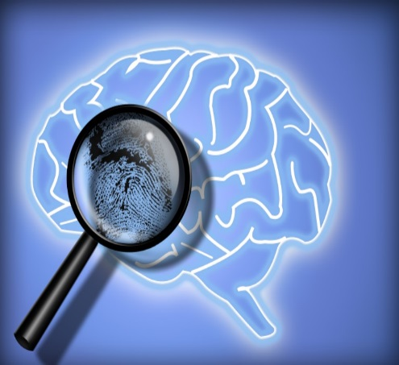
Your thoughts become actionS
Imposter Syndrome-The belief that you are not as capable as others perceive you to be is a result of internalized negative thinking.
Stereotypes
Lack of appropriate role models
Poor self-concept
Affects women, people of color and underrepresented groups in math and science.
Watch your thoughts; they become words.
Watch your words; they become actions.
Watch your actions; they become habits.
Watch your habits; they become character.
Watch your character; it becomes your destiny.
- Unknown
Leaders, if you're feeling like you don't belong or aren't good enough, know this: Doubts don't mean you're not capable. They show you're pushing yourself. It's okay to feel unsure sometimes. Talk to mentors and others who understand. Believe in yourself, recognize your successes, and keep leading with honesty and strength.

Slide 23
LEADERSHIP IMPLICATIONS for USING EMOTIONS
All Humans Must Learn to Express
All behavior and prosocial responses are learned
Match your teaching /leading state to learning state
Understand the states of others when giving information and tasks
Empathy
Optimism
Sympathy
Humility
Forgiveness
Compassion
Patience
Shame
Cooperation
How do you support those you lead to develop appropriate expressions of these states?

Slide 24
Rule#4 - Brains need meaning to function
“Twas brillig and the slithy toves
did gyre and gimble in the wabe.
All mimsy and the borrow groves
and the moonraths outgabe.”
Brains need meaning to lead, learn, and be motivated. Leaders can benefit from this brain principle by making sure that their expectations are clear and meaningful to those in their sphere or influence.
The brain must make meaning of information to process and understand it. Attention is secondary. The brain is poorly designed to learn rote isolated facts that are not attached to meaningful events. Choice increases meaning and the success rate of the learner. The brain is an excellent pattern maker and seeks to connect old learning to the new. Novelty increases the brain’s ability to attend and attach new information to the old.

Slide 25
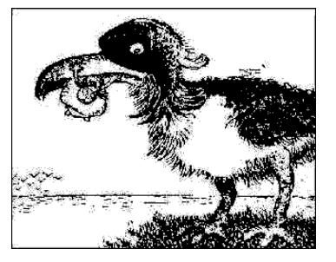
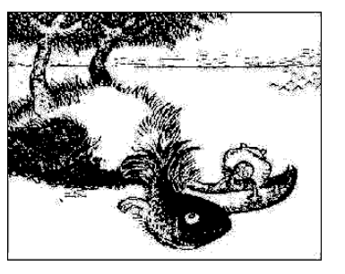
What DO You SEE?
Our perceptions shape what we see. We see the world as we are, not necessarily as it is.
What do you think other in the room see? Ask them
Notes:
The picture at the top is a bird with a worm in its mouth. When the same picture is flipped, it looks like a man in a boat catching a very large black fish. Our perception is what we see using the neural hardware of the brain.
Meaning is what we make of this sensory input. This meaning is a result of our experiences, abilities and expectations. So it is possible for two different people to hear or see the same event and have a different conclusion.

Slide 26
RULE #5 - Brains Operate in Cycles and rhythms
The brain is poorly designed for on task behavior
Cycles of on and off and attention go throughout the day and night
Hormones fluctuate on daily, monthly, and on yearly cycles and the fluctuations affect behavior, motivation and learning
Nap and rest times are brain appropriate for children and staff
LEADERSHIP IMPLICATION
Breaks and down time is valuable brain building and processing time. Vacation and time -off are brain system storage and renewal times.
Notes:
Break time and down time are not necessarily wasted work time. The brain can either make meaning or pay attention. It cannot do either 100% of the time. Each new task requires down time to allow the brain to make the necessary connections. New nerve cells must be allowed to connect to the old for new learning to be meaningful. The brain naturally shifts hemispheres every 90 minutes in an on/off cycle. Natural leaders respect on/off brain cycles and adjust work demands based on this feedback.

Slide 27
Rule # 6 - Social Interactions are innate
The human brain is a social brain. Attachment and bonding are key to building relationships
The brain grows and develops from interactions and experiences with others. Isolation, apathy, neglect, or poor stimulation deprive the brain of the necessary stimuli to make healthy connections.
Learning centers and cooperative curriculum are brain compatible ways to use this brain natural learning design to benefit educational goals.

Slide 28
MIRROR NEURONS
The Mirror Neuron system needs real world interactions to properly wire prosocial behavior and meaning.
Being there and personal simulations are better for brain wiring than talk and worksheets.
Worksheets have limited value in building brain networks!
LEADERSHIP IMPLICATIONS: LEAD BY EXAMPLE
Do as I do is more likely the teaching model
Limit words, increase appropriate actions
Reward behavior you want with celebrations, actions and purpose

Slide 29

Rule#6-Brain is a mUlti-Level processor
Brain processes 19 different kinds of sensory information at the same time.
Sight, Taste, Hearing, Smell, Touch, Vomernasal, Ultraviolet, Proximal, Electrical, Pain, Balance, Vestibular, Barometric, Geogavimetric, Temperature, Eidetic Imagery, Magnetic, Infrared and Ionic make up the 19 kinds of sensory information processed sometimes simultaneolusly
Notes:
The brain can and does process many different kinds on information at one time. There are four brain lobes that process different kinds of information and integrate this information at nana speeds for action. When a child is asked to respond to a question in class, think a bout what discrete functions the brain has to manage at the same time. The eyes scan the scene for any threats to survival and for non-verbal content relevant to the questions. The ears must transmit discrete bits of sound to the auditory cortex in the temporal lobe for interpretation . Be fore that, the bits of sounds were evaluated in different parts of the brain depending on whether they were nouns, verbs etc. If you were a non native speaker, these operations may be located in different areas and the brain needs to find them. Meanwhile the parietal lobe is integrating the words and sounds together to formulate a response. The frontal lobe has been attentive to making meaning out of the questions and retrieving stored information that may be relevant to their response. He deep limbic systems must make sure that the appropriate emotional content is added and must also interpreted how the questions was asked and closely monitor threats. The hippocampus monitors the information and will be in charge of storing information in short term and alter long term memory. All this and more is happening at nano second speeds without conscious thought . Children with damage brain systems may not be able to encode and encode informational s rapidly as needed to make meaning and to respond.

Slide 30
19 Senses
SENSE | BRAIN INPUT | BEHAVIOR WE CAN DO OR OBSERVE
Sight | Light that is visible | Look at books, objects, people and our environment. The up-side down image is captured by the eyes and this visual information travels along the optic nerve to the sight center (Occipital Lobe) at the back of the brain to be processed into pictures.
Taste | Chemical molecules that excite our taste buds | Taste food or other objects put in our mouths. Works in conjunction with the sense of smell. Taste buds on the tongue and around the mouths of infants process sweet, sour, salty, bitter and umami (savioriness) tastes which are processed in the brain.
Hearing | Air Vibrations | Hearing sounds which are vibrations that are picked-up through our ears and are processed by the brain’s auditory cortex in the temporal lobe.
Smell | Chemical Molecules | Smell aromas in the air. Molecules are dissolved in air and inhaled. Processed immediately by the olfactory center in the brain, the sense of smell is the only sense not routed through the thalamus.
Touch | Tactile Contact | Distinguishing between objects and people by touch.
Vomernasal | Pheromonic Sensing | Subconsciously respond to pheromones in mating and bonding.. The vomeronasal structure is in the nose.
Ultraviolet Rays | Short Electromagnetic Waves | Sensed on the skin as sunburn.
The five sense organs: eyes, nose, ears, mouth, and skin. These organs manage different kinds of sensory information

Slide 31
Proximal | Physically Close | Feeling when objects or people are close. The sight-limited have this sense heightened.
Electrical | Surface Electrical Charges | Our bodies have a surface electrical charge that is transmitted to others on touch.
Pain | Nocioception | Recognizing many types of noxious stimuli that are sensed by the skin.
Balance | Kinesthetic Geotropic | Maintaining balance when walking, running and balance by adapting to gravity.
Vestibular | Repetitious Movement | This sense helps us remain upright when objects or we move.
Barometric | Atmospheric Pressure | Forecasting the weather. When the air pressure changes, we sense this through the skin, ears, and joints.
Geogravimetric | Sensing mass Differences | Distinguishing between the size, mass and density of objects by touch.
Temperature | Molecules in Motion | When molecules move fast we sense this as heat and slower moving molecules are experienced as cooler.
Eidetic Imagery | Neuro-electrical Image Retention | Images conjured up in our minds. “ In my mind’s eye, I see. . .”
Magnetic Waves | Ferromagnetic Orientation | Sensing the pull of a magnetic field such as in a Magnetic Resonance Imaging (MRI) device.
Infrared Rays | Long Electromagnetic Waves | Part of the white light spectrum that are sensed on the skin
Ionic Rays | Ionic Charges | When the air contains many negative ions, we feel refreshed (like after a rain) and when there are an abundance of positive ions, the air feels heavy. (Before a rain)

Slide 32
Brain appropriate leadership is. . .
Flexible, sometimes unpredictable
Dynamic
Often self-correcting, moderately instructive
Noisy
Challenging
Element of risk but not unsafe
Cyclical (Busy vs Brain Timeout Time)
Social
Low Threat
Allows Patternmaking for Meaning

Slide 33
WORDS TO LEAD BY
The sixth most important words: "I admit I made a mistake."
The fifth most important words: "You did a good job."
The fourth most important words: "What is your opinion."
The third most important words: "If you please."
The second most important words: "Thank you,"
The first most important word: "We"
The least important word: "I

